Slide 1
Can you identify the types of fibers shown?
Think About It …
Which samples are natural fibers?
(2) Which samples are synthetic fibers?
(3) What characteristics can be used to identify fiber samples?

Slide 2
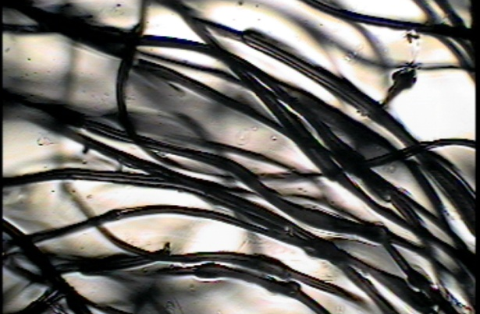
A

Slide 3
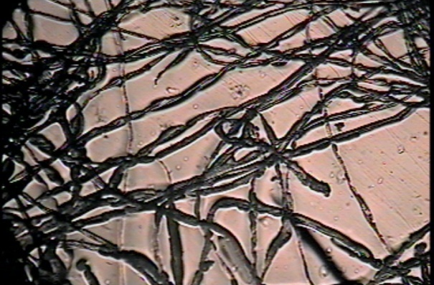
B

Slide 4
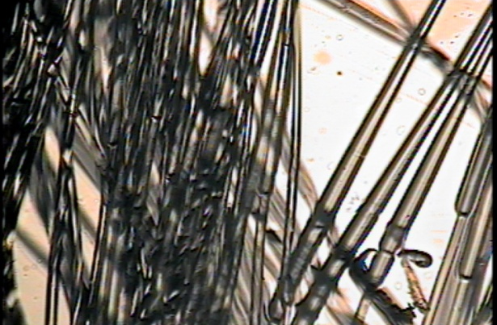
C

Slide 5
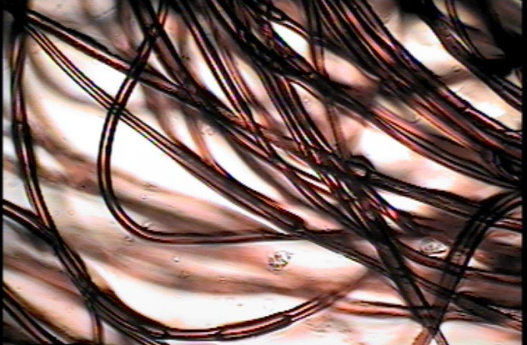
D

Slide 6
E

Slide 7
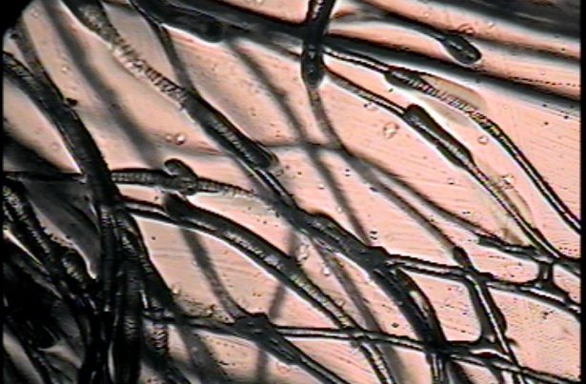
F

