Slide 1
Arson and Fire investigation

Slide 2
Investigation
Fire investigation involves the examination of all fire-related incidents once firefighters have extinguished the fire. The practice is similar to the examination of crime scenes in that the scene must be preserved and evidence must be collected.
The primary purpose of the investigation is to establish an origin(seat) of the fire.

Slide 3
Investigation cont.
The investigation will most likely include a close survey of the damamged scene to establish the orgin of the fire.
In order to effectively evaluate the fire, the investigator must have detailed knowledge of chemistry, behavior of fire, and its effect.

Slide 4
Nature & Chemistry of Fire
Fire occurs due to the exothermic reaction of combustion(Burning), produce both heat and light.
For fire to occur there must be three vital components present: Fuel, Oxidant(O2), and Energy.

Slide 5
Nature & Chemistry cont.
Fuel – Fuels are any materials that store potential energy that can be used for work or as heat energy.
Fuel can be organized into several types, this includes Solid Fuels(Coal), Liquid Fuels(Gasoline) and Gaseous Fuels(Methane).
Fuel is what powers the fire, so the more of it you have, the longer the fire will burn.

Slide 6
Combustion
Some oxidation reactions are called combustion reactions.
Combustion Chemical reactions that release heat are called exothermic reactions.

Slide 7
Types of Fires
Class A – Class A fires consist of ordinary combustibles such as wood, paper, trash or anything else that leaves an ash. Water works best to extinguish class A fires.
Class B – Class B fires are gueled by flammable or combustible liquids, which include gasoline, and other similar materials. Smothering effects which deplete the oxygen supply work best to extinguish Class B Fires
Class C – Electrical Fires. Fires that involve electrical equipment

Slide 8
Types of Fires cont.
Class D – Class D Fires are combustible metal fires, Magnesium and Titanium are the most common types of metal fires. Once a metal ignites water will never be able to extinguish it.
Class K – Class K Fires are fires that involve cooking oils, grease or animal fat and can be extinguished using Purple Km the typical agent found in kitchen or galley extinguishers.

Slide 9
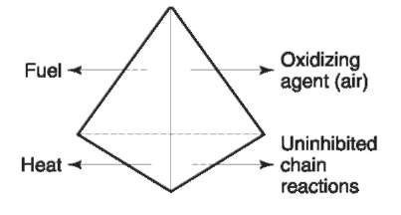
The Fire Tetrahedron
The four ingredients that are needed to keep a fire going .

Slide 10
Flash Point and Ignition Temperature
Most Hydrocarbon accelerants(Gasoline, Kerosene, and Lighter Fluid) need to be in a gas state in order to react with oxygen.
When a liquid changes to a gas state, the process is called vaporizing. For a liquid to burn, there must first be enough heat to vaporize the liquid.
The lowest temperature at which this occurs is called the flash point.

Slide 11
Pyrolysis
Solid fuels, such as wood, are not flammable. However, vapors given off from the resin in the wood are flammable and will burn. As the wood itself decomposes in the fire, additional flammable vapors are released.
The process of decomposition caused by heat in the absence of oxygen is called pyrolysis.
Charcoal will not burn unless a liquid fuel is applied.

Slide 12
Point of Origin
The point of origin at a can provide clies about the cause of a fire. The point of orin will be marked buy a burn pattern. There often is a V-shaped burn near the point of origin. This shaped is caused as the fire travels us from the point of origin.

Slide 13
Types of Patterns
Classic V – Burn pattern narrower at bottom and spreads outward as it rises.
Inverted Cone – Burn patter is wider along the floor and narrower as it burns upward.
Streamers – Burn patter that shows a trail from one area to antoher.

Slide 14
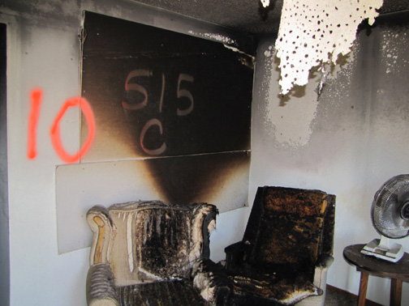
Types of Patterns
Notice the V Shape

Slide 15
Lab Analysis
Fore investigators will send all of the evidence to the lab fir analysis. At the lab forensic scientists will try to determine exactly what accelerant residue from the collected debris is called direct headspace extraction procedure.
The container is heated, the vapors move to the top of the container where a syringe is stuck to extract the vapors.
The extracted vapors are then sent to the lab for chromatography analysis.

Slide 16
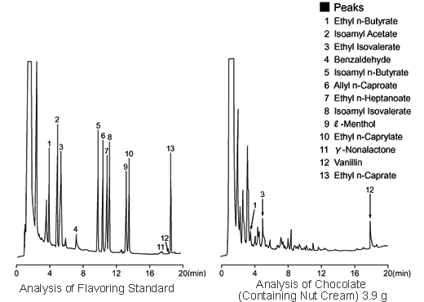
Lab Analysis
Chromatography Comparison

Slide 17
Characteristics of an Arsonist
Criminal Profilers have put together a list of characteristics that have been found in most arson cases.
The list of characteristics includes the following

Slide 18
Characteristics
Less than 25 years old
Father not in the home
Domineering mother
Academically challenged
Emotionally and / or psychologically disabled
Unmarried, possibly still living at home with parents
Feelings of inadequacy and insecurity
Fascination with fire
Alcoholism
Parental neglect or abuse

Slide 19
Motives for Arson
Financial Gain – Some fires are started for financial gain, usually through insurance fraud.
Revenge – A fire stated to destroy an organization or a person for the sake of a cause.
Excitement – Fire started by someone who might be bored for seeking attention.
Vanity –Sometimes the person who sets the fire wants to make themselves look like a hero. They crave positive attention.
Crime Concealment – Some fires are started to destroy evidence of another crime.

