Slide 1
Safety, Precision & Accuracy
9/2/14 Chemistry

Slide 2
Drill
Pick up a safety contract and read over it.
Which is the most important safety rule, in your opinion? Why?
HW: What Not To Do Lab WS

Slide 3
Objectives
IWBAT
Explain safety precautions for the chemistry lab.
Define and apply concepts of precision and accuracy

Slide 4
Missing Forms – Pd. 1
Parent Sign– Off AND Self- Inventory
Chris B.
Amoyiah J.
Parent Letter ONLY
Scott B.

Slide 5
Safety
Let’s watch the safety videos.
DVD
https://www.youtube.com/watch?v=XYbOSmYme6Y
We will also do a safety “tour” of the room and look at the safety contract.
Do you know what to do for the drills?
Fire? Duck, cover, and hold? Lockdown?

Slide 6
Precision & Accuracy
Please prepare to take notes.
Precision and Accuracy Activity:
I will draw a target on the board and explain

Slide 7
Precision & Accuracy
What is precision?
Precision is how close a series of measurements are to each other.
What is accuracy?
Accuracy is how close a measurement is to a “standard”. For example, the center of a bullseye.

Slide 8
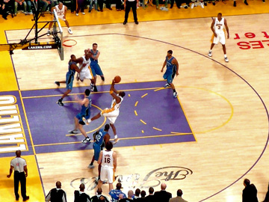
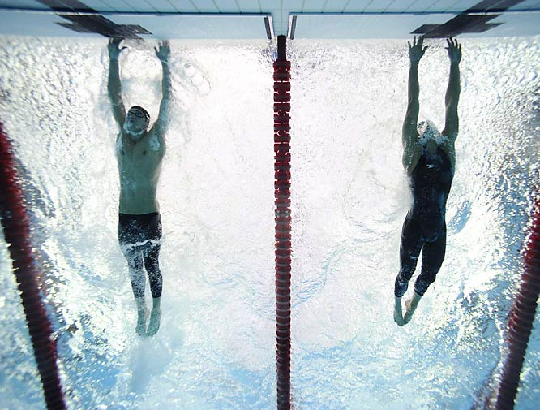
Sports Examples Which requires P or A?
http://blog.affinitymed.com/wp-content/uploads/2009/06/6-7-09-kobe-shooting-in-the-paint-small.jpg
http://i.cdn.turner.com/si/multimedia/photo_gallery/0808/oly.phelps.sequence/images/opgm-37117-mid.jpg

Slide 9
Closure
What is the proper way to smell a chemical?

