Slide 1
Forensic Science 9/1/15

Slide 2
Drill
Pick up papers in front of classroom. Staple them to make a packet:
  Ch 1 Review Questions (2 sheets)
  Ch 1 Fill-in-the-blank (1 sheet)
  Chapter 1 Notes sheet (1 sheet)
What are five traits of a good witness, in your opinion?
What is the most important safety rule?

Slide 3
Objectives
IWBAT
  Observe crimes carefully, and recall them later
  Explain the function of forensic scientists
HW:
  Finish “That’s My Story and I’m Sticking To It” if needed
  Begin to read Chapter 1 in the textbook. The review questions will be due next Monday, 9/8

Slide 4
Agenda
Drill
Work on Observation Lab table & Questions – Book Sign-Out
Begin Chapter 1 Notes
Closure

Slide 5
Observation lab – Part II
Fill out the Data Table.
Once you have finished, flip it over and answer the Post-lab Questions.
Staple your three sheets together and turn in when done.
Ms. Bloedorn will call you up to check out books while you work.

Slide 6
Intro to Forensic Science
Chapter 1

Slide 7
Definition
Forensic science is the application of science to criminal and civil laws.
This course emphasizes the application of science to those criminal and civil laws that are enforced by police agencies in a criminal justice system.

Slide 8
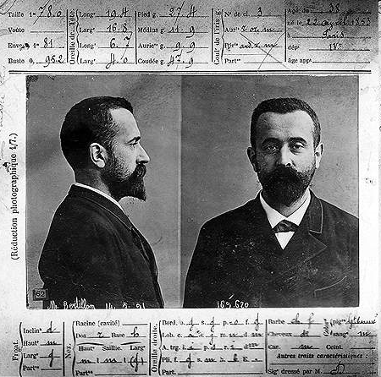
History
Alphonse Bertillon—devised the first scientific system of personal identification in 1879.

Slide 9
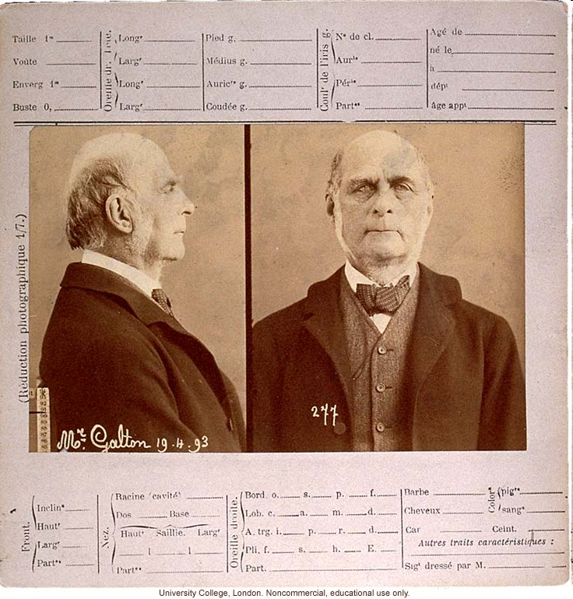
Francis Galton—conducted the first definitive study of fingerprints and their classification.

Slide 10
History
Edmond Locard—applied scientific principles to the field of criminal investigation within a workable crime laboratory.
  Locard’s Exchange Principle—states that when a criminal comes in contact with an object or person, a cross-transfer of evidence occurs.

Slide 11
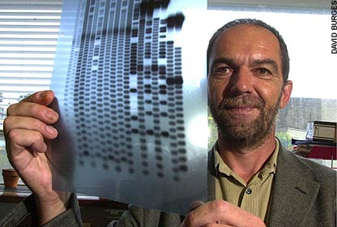
Sir Alec Jeffreys—developed the first DNA profiling test in 1984.

Slide 12
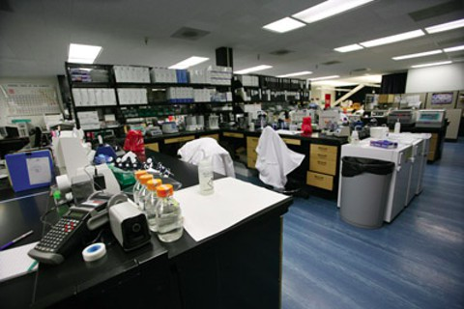
The Crime Lab
The development of crime laboratories in the United States has been characterized by rapid growth accompanied by a lack of national and regional planning and coordination.
At present, approximately 350 public crime laboratories operate at various levels of government—federal, state, county, and municipal.

Slide 13
The Crime Lab
The ever increasing number of crime laboratories is partly the result of the following:
  Supreme Court decisions in the 1960s responsible for police placing greater emphasis on scientifically evaluated evidence.
  Crime laboratories inundated with drug specimens due to accelerated drug abuse.
  The advent of DNA profiling.

Slide 14
Four Major Federal Crime Laboratories
Four major federal crime labs are:
  FBI – largest crime lab in the world; Quantico, VA
  DEA (Drug Enforcement Administration)
  ATFE (Alcohol, Tobacco, Firearms, and Explosives)
  U.S. Postal Inspection Service
  Each offers its expertise to any local agency that requests assistance

Slide 15
Technical Support
The technical support provided by crime laboratories can be assigned to five basic services.

Slide 16
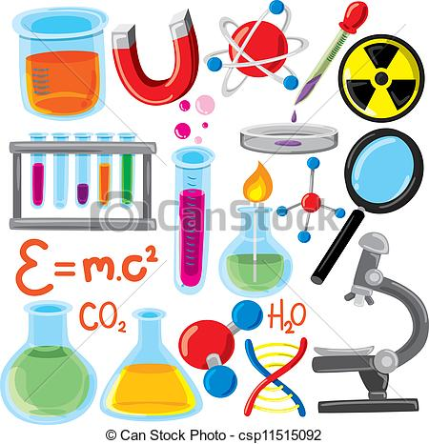
  Physical Science Unit incorporates the principles of chemistry, physics, and geology to identify and compare physical evidence.

Slide 17

  Biology Unit applies the knowledge of biological sciences in order to investigate blood samples, body fluids, hair, and fiber samples.

Slide 18
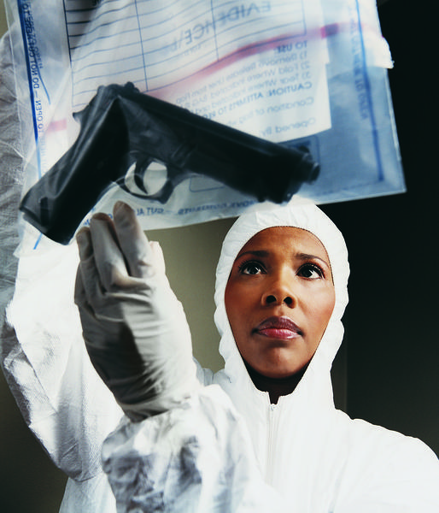
  Firearms Unit investigates discharged bullets, cartridge cases, shotgun shells, and ammunition.

Slide 19
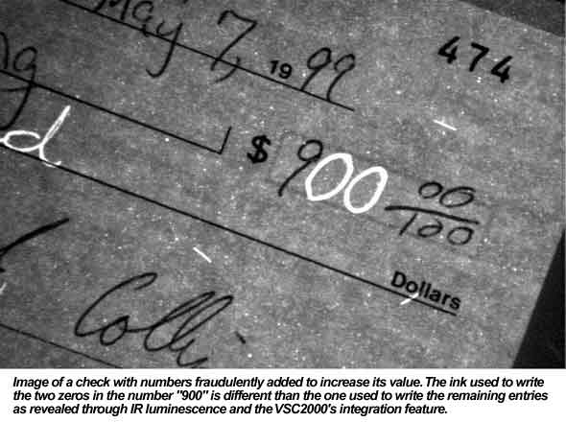
  Document Unit provides the skills needed for handwriting analysis and other questioned-document issues.

Slide 20
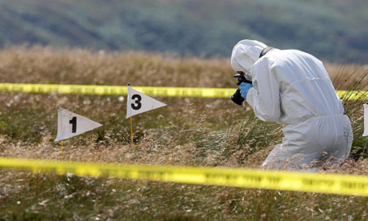
  Photographic Unit applies specialized photographic techniques for recording and examining physical evidence.

Slide 21
Skills of a Forensic Scientist
A forensic scientist must be skilled in applying the principles and techniques of the physical and natural sciences to the analysis of the many types of evidence that may be recovered during a criminal investigation.
A forensic scientist may also provide expert court testimony.
An expert witness is an individual whom the court determines possesses knowledge relevant to the trial that is not expected of the average person.

Slide 22
Skills of a Forensic Scientist
The expert witness is called on to evaluate evidence based on specialized training and experience that the court lacks the expertise to do.
The expert will then express an opinion as to the significance of the findings.
Forensic scientists also participate in training law enforcement personnel in the proper recognition, collection, and preservation of physical evidence.

Slide 23
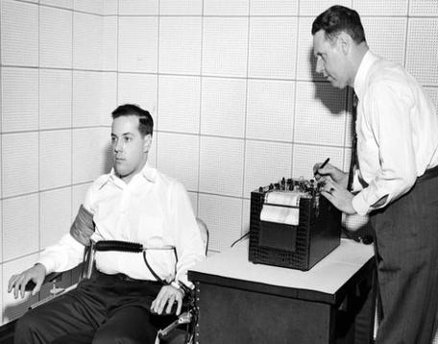
The Frye Standard
The Frye v. United States decision set guidelines for determining the admissibility of scientific evidence into the courtroom.

Slide 24
Frye Standard
To meet the Frye standard, the evidence in question must be “generally accepted” by the scientific community.
What did the Frye case deal with?

Slide 25
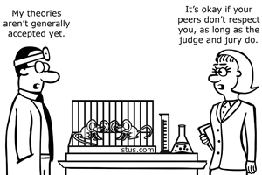
Frye Not Absolute
However, in the 1993 case of Daubert v. Merrell Dow Pharmaceutical, Inc., the U.S. Supreme Court asserted that the Frye standard is not an absolute prerequisite to the admissibility of scientific evidence.

Slide 26
Daubert Standard
Trial judges were said to be ultimately responsible as “gatekeepers” for the admissibility and validity of scientific evidence presented in their courts, as well as all expert testimony.

Slide 27
Daubert Criteria For Admissibility
Whether the scientific technique or theory can be tested.
Whether the technique has been subject to peer review and publication.
The techniques potential rate of error.
Existence and maintenance of standards .
Whether the scientific theory or method has attracted widespread acceptance within a relevant scientific community.

Slide 28
Special Forensic Science Services
A number of special forensic science services are available to the law enforcement community to augment the services of the crime laboratory.
These services include forensic pathology, forensic anthropology, forensic entomology, forensic psychiatry, forensic odontology, computer science, and forensic engineering.

Slide 29
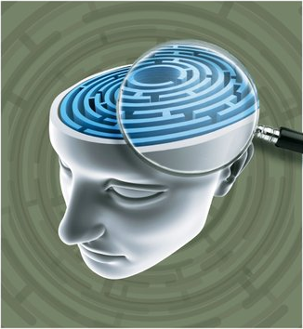
Special Forensic Science Services
Forensic Psychiatry is an area in which the relationship between human behavior and legal proceedings is examined.

Slide 30
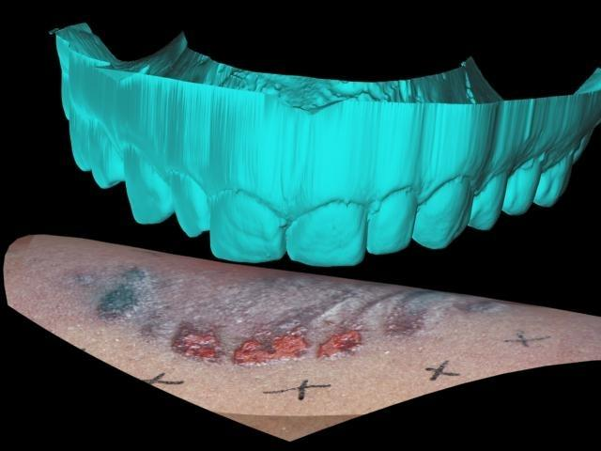
Forensic Odontology involves using teeth to provide information about the identification of victims when a body is left in an unrecognizable state. Also investigates bite marks.

Slide 31
Forensic Engineering is concerned with failure analysis, accident reconstruction, and causes and origins of fires or explosions.
Forensic Computer Science involves the examination of digital evidence.

Slide 32
Closure
Let’s do a few of the fill in the blanks, based on the notes.

