Slide 1
Equilibrium Practice
Chemistry 6/11/15

Slide 2
Drill
Pg. 5 – Equilibrium Constant
Write out the K_{eq} for each reaction
HW: Finish pg. 7 – Chemical Equilibrium

Slide 3
Objectives
IWBAT
explain chemical equilibrium as a dynamic system.
use Le Chatelier’s Principle to predict the effects of changes to a chemical system.
Describe the factors that affect reaction rate.
Explain reaction rate using Collision Theory

Slide 4
Agenda
Drill
Finish Le Chatelier’s Principle Notes
Practice Le Chatelier’s Principle
Review all
Closure

Slide 5
Equilibrium & Le Chatelier’s Principle Notes
Equilibrium PPT (separate file)

Slide 6
NOTE: K_{eq} and Stresses on the system
K_{eq} does not change with change in concentration
It will change based on change in temperature and change of pressure

Slide 7
Le Chatelier’s Principle Practice
Turn to pg. 5 and predict the shifts

Slide 8
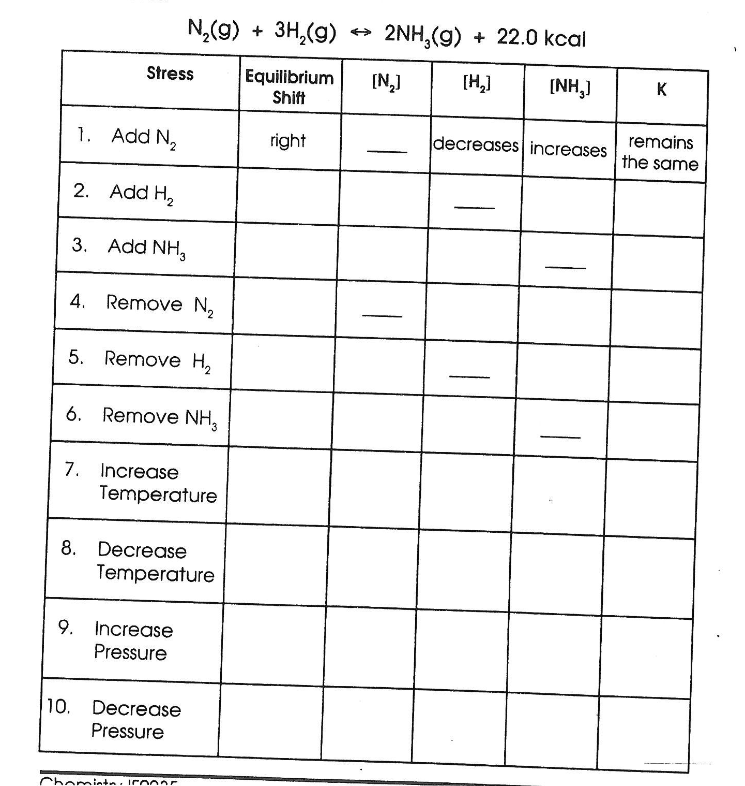

Slide 9
Review All
Turn to pg. 7– Chemical Equilibrium WS
Cross out #5a, 5c, 8, 9
#11 (on back) – draw in an exothermic reaction curve
Ms. Bloedorn will wander to assist—check your work as you finish each problem

Slide 10
Closure
What factors will increase reaction rate?
What factors will shift an equilibrium?
Which are the same?

