Slide 1
Equilibrium & ICE Tables
Chemistry GT
6/10/15

Slide 2
Drill
Let’s go over the back of pg. 7 (and the front)
HW:

Slide 3
Objectives
IWBAT
explain chemical equilibrium as a dynamic system.
use Le Chatelier’s Principle to predict the effects of changes to a chemical system.
Describe the factors that affect reaction rate.
Explain reaction rate using Collision Theory

Slide 4
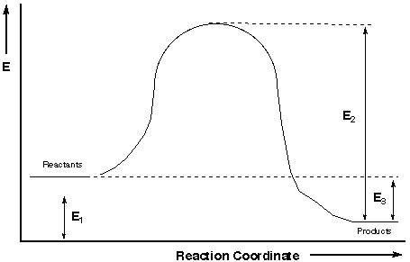

Slide 5
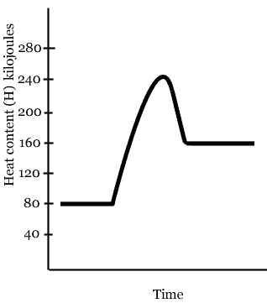

Slide 6
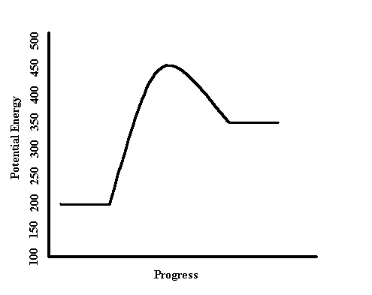

Slide 7
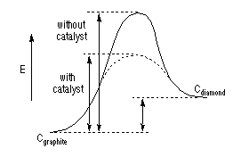
Explain the changes that happen when a catalyst is added.

Slide 8
Pg. 7
Energy Diagram—any questions?

Slide 9
Le Chatelier’s Principle Continued Review
Let’s quickly review pg. 3

Slide 12
Equilibrium Constant Notes

Slide 13
Equilibrium Constant
Expresses the relative concentrations of reactants and products at equilibrium by using an “equilibrium constant” – K_{eq}
a A + b B ⬅➔ c C + d D

Slide 14
Equilibrium Constant
Only include gases and aqueous solutions when writing equilibrium constants
Solids and liquids are not included
They can be represented with a [1] or left out entirely

Slide 15
Types of Equilibrium Problems
Quantitative
K_{eq} < 1, then the reaction is reactant-favored at equilibrium
COCl_{2(g)} ←→ CO_{(g)} + Cl_{2(g)}
K_{eq} = 2.2 x 10⁻¹⁰
Reactant-favored

Slide 16
Types of Equilibrium Problems
K_{eq} > 1, then the reaction is product-favored at equilibrium
2 NO_{2(g)} ←→ N₂O_{4(g)}
K_{eq} = 2.15 x 10²
Product-favored

Slide 17
K_{eq} and Stresses on the system
K_{eq} does not change with change in concentration
It will change based on change in temperature and change of pressure

Slide 18
Types of Equilibrium Problems
Quantitative (uses the K_{eq} equation)
Write the equilibrium expression for the following reaction
2 SO_{2(g)} + O_{2(g)} ←→ 2 SO_{3(g)}
[SO₃]²
[SO₂]² [O₂]
K_{eq} = ____________

Slide 19
Types of Equilibrium Problems
If .0172 M of O₂, .0250 M of SO₂ and .00140 M of SO₃ at equilibrium, calculate K_{eq}
[SO₃]²
[SO₂]² [O₂]
[.00140]²
[.0250]² [.0172]
K_{eq} = ___________ =
_______________
K_{eq} = .18 (reactant favored)

Slide 20
ICE Tables
What is an ICE Table or ICE Box?
It is a way to do Equilibrium problems—now that we know that a reaction at a given temperature has a certain K_{eq}, let’s use it to calculate how MUCH product we can make!

Slide 21
ICE Box Problems
Pg. 5
Let’s do some ICE, ICE, baby!

Slide 22
Closure
Which would you like to have for a drill tomorrow?
ICE Box
Le Chatelier’s Principle
Reaction Energy Diagram

