Slide 1
Dollhouse Crime Scene Day 2
Forensic Science
5/7/15

Slide 2
No Drill
HW: Work with your partner to plan your crime scene

Slide 3
Objectives
IWBAT
Learn about dollhouse scale crime scenes to inspire my dollhouse scale crime scene
Plan and sketch my dollhouse crime scene

Slide 4
Of Dolls and Murder
Let’s finish Of Dolls and Murder, to get inspiration:
Pd. 3 – 34:58
Pd. 5 – 34:56
Pd. 6 – 31:29

Slide 5
Summative Project
Due Date – End of class on 5/13
Grade
34% towards Tests/Quizzes
33% towards HW/CW
33% towards Labs
You and your partner will share a grade worth 100 pts.

Slide 6
Project
Let’s go over the requirements
NOTE: No sexually oriented crimes!!!!
You may use a computer at school or at home, with your partner, to write the summary and “Know-It-All” information.

Slide 7
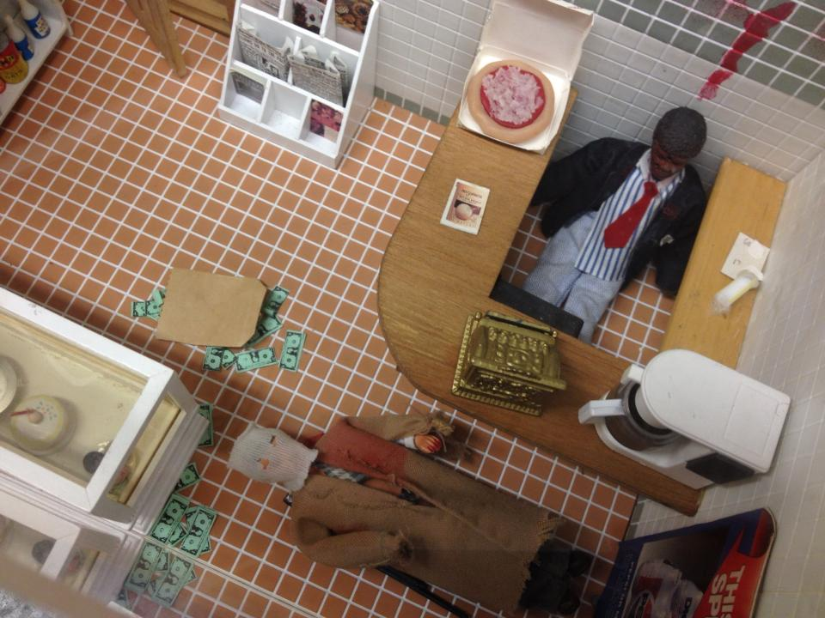

Slide 8
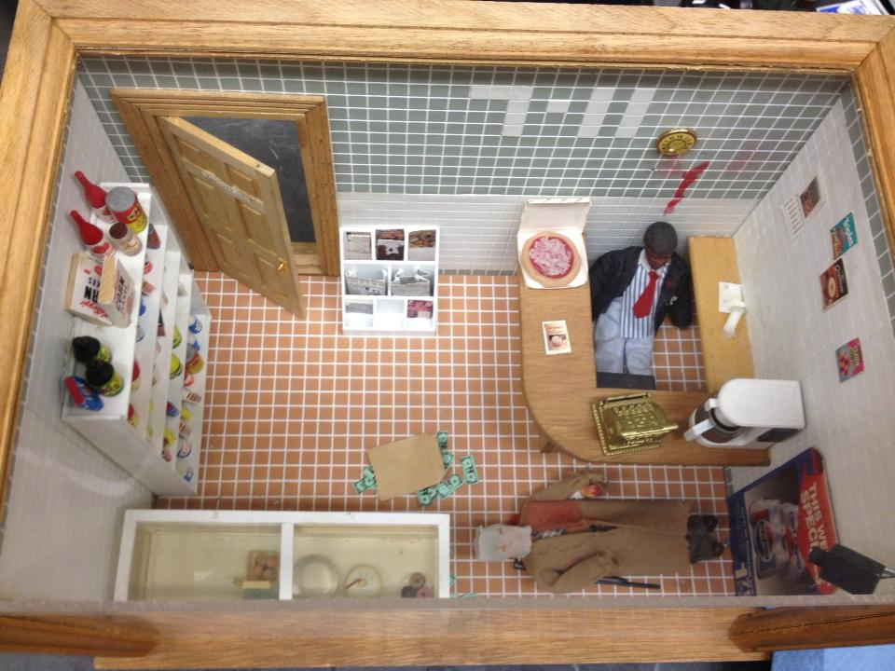

Slide 9
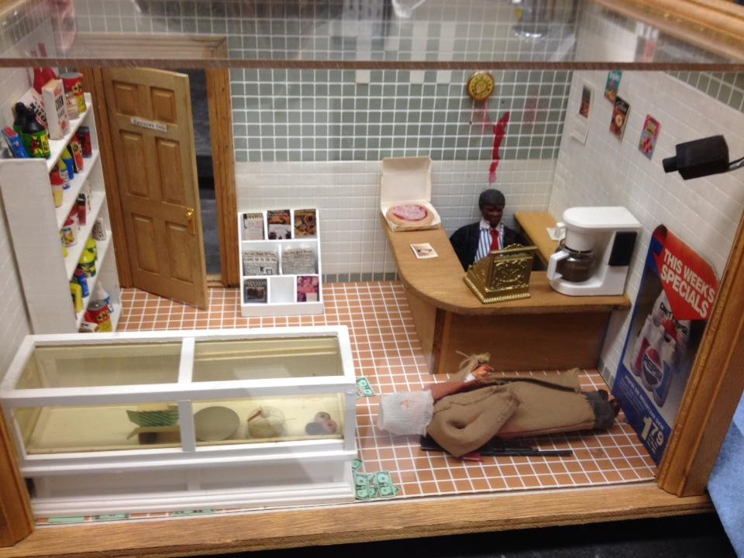

Slide 10
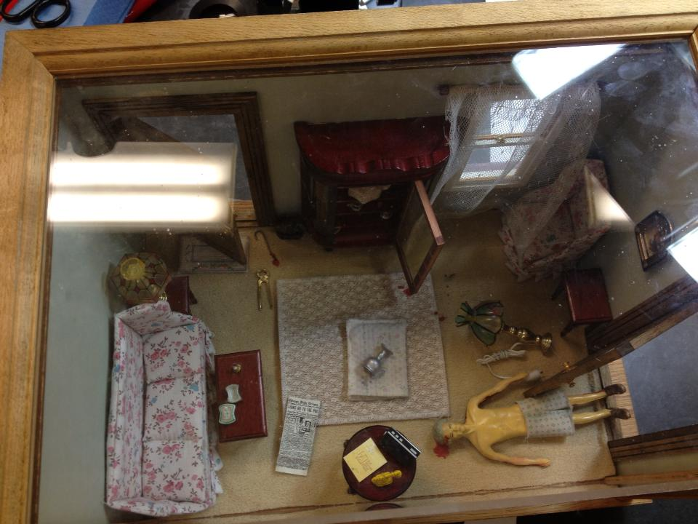

Slide 11
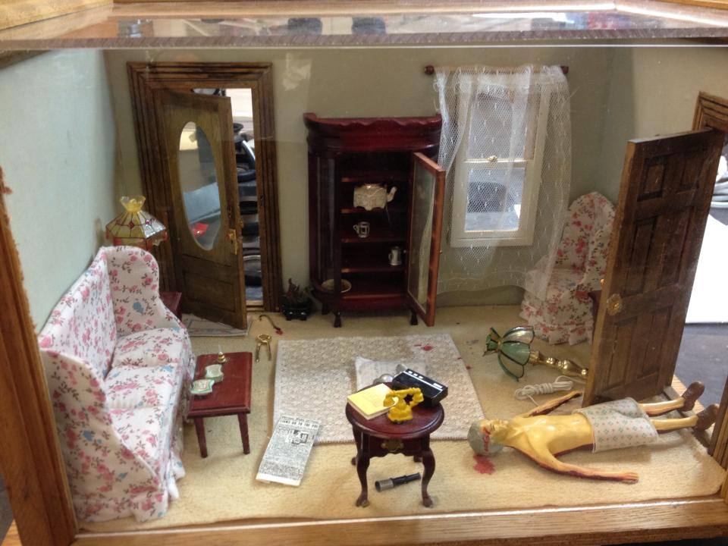

Slide 12
Project
My project – The Mysterious Death of Mrs. Thomas
Three projects from last year—all are extremely good!

Slide 13
What now?
Choose a partner or trio
Brainstorm ideas for a crime
Murder? B&E? Theft? Kidnapping?
No suicide or accidental death
Sketch a rough layout for your crime on a piece of paper
Decide on the toys (and scale)

Slide 14
Closure
What type of crime are you going to represent?
What materials do you need?

