Slide 1
Things that aren’t Solutions, Molarity, Dilutions
Chemistry 5/7/15

Slide 2
Drill
Did you NOT finish the Gas Laws Multiple Choice? Now is your time!
pg. 1 #5
What does CuSO₄•5H₂O mean??
HW: pg. 4. Dilutions WS

Slide 3
Objectives
IWBAT
Calculate molarity given moles, liters, or grams
Calculate dilutions of solutions

Slide 4
Agenda
Drill
Things that are NOT Solutions Notes
More Molarity and Dilution Practice & HW Review
Closure

Slide 5
Mixtures that are like Solutions, but aren’t Solutions!
Suspension
Mixture where particles eventually settle to the bottom
Particles are MUCH bigger than a solution. They may be visible
ex. Chocolate is suspended in hot chocolate or chocolate milk
ex. Tiny particles of dirt (silt) are suspended in river or pond water

Slide 6
Like Solutions, but not, cont.
Colloid
Mixture containing particles of a size between suspension and true solution
The particles are not actually dissolved, but also not as large as a suspension’s particles.
Particles remain dispersed (do not settle out), but not dissolved:
may appear cloudy: ex. fog, aerosols, smoke, plain milk
This is called the Tyndall Effect – it causes sunsets!
may appear as something between two phases: ex. Jell-o

Slide 7
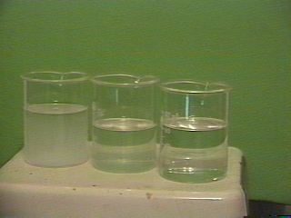
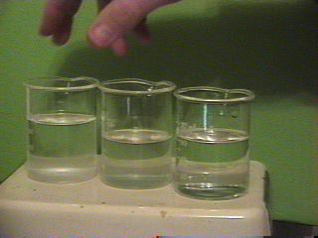
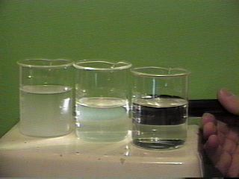
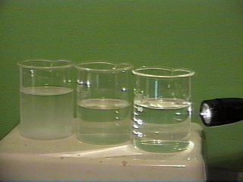
Suspension, Colloid, Solution (L to R)
A Solution’s particles DON’T reflect light - looks clear!
Notice that the particles have settled out of the Suspension
A Colloid’s particles reflect light
http://dl.clackamas.cc.or.us/ch105-03/similar.htm

Slide 8
Like Solutions, but not, cont.
Emulsions
Colloidal dispersions of liquid in liquid
Tiny particles of one liquid dispersed in another liquid, but NOT dissolved.
These are held together by an emulsifier:
An emulsifier causes two immiscible liquids to mix because one end is polar and one is nonpolar.
ex. egg in mayonnaise, soap in soapy water

Slide 9
HW Review
Let’s put up those problems

Slide 10
Molarity & Dilution Practice
Let’s practice with
pg. 6 #1-4
On the board!!!

Slide 11
Exit Ticket
You are making 1.0 L of a 0.20 M solution of Kool-Aid. Kool-Aid is mostly sucrose, C₁₂H₂₂O₁₁. How many grams of Kool-Aid do you need to mass out?

