Slide 1
Solutions Notes & Demos
Chemistry 5/5/15

Slide 2
Drill
Name the solute and the solvent for:
sugar water
air
20 K gold (83% Au, 17% Ag)
10 K gold (42% Au, 58% Ag)
carbonated water
HW: Finish Solutions Review Sheet

Slide 3
Objectives
IWBAT
Define solute, solvent, solution, and homogenous mixture.
Give an example of each of the above items.
Give examples of all solute-solvent combinations.
Explain rate of solution and solvation.

Slide 4
YOU ANSWER
Is everything miscible with everything else?

Slide 5
Like dissolves like.
Substances with similar bonds dissolve into each other.
Polar & Polar
Water and Isopropanol (Rubbing Alcohol)
Polar & Ionic
Water and most Salts (NaCl, CaCl₂, KI, etc.)
Nonpolar & Nonpolar
Nail Polish and Nail Polish Remover
Oil Paint and Terpentine

Slide 6
Why doesn’t oil dissolve in H₂O?
Oils are non-polar molecules.
Water is a polar molecule.
Molecules with unlike bonds do not dissolve into each other.
Oil -
No charge on the molecule
H
H
Water -
Separation of
Charge
O

Slide 7
Describe NaCl dissolving in H₂O
Water is a dipole.
NaCl dissociates into Na+ ions and Cl- ions.
The - end of the H₂O molecule is attracted to the Na+ ion in the salt crystal and pulls it into the water.
The + end of the water is attracted to the Cl- ion.

Slide 8
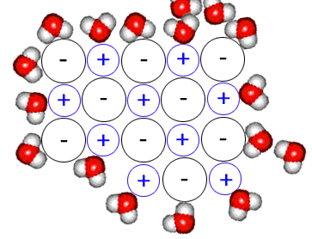
http://nobel.scas.bcit.ca/chem0010/unit9/9.4_solubilityionic.htm

Slide 9
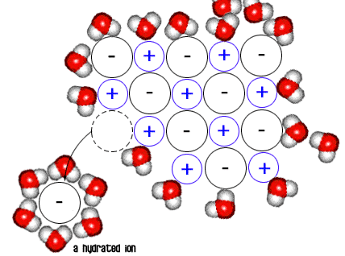
http://nobel.scas.bcit.ca/chem0010/unit9/9.4_solubilityionic.htm

Slide 10
Concentrations of Solutions
Unsaturated -- A solution that contains less than the maximum amount of solute that can be dissolved at that temperature.
Saturated Solution -- A solution containing the maximum amount of solute that can be dissolved at that temperature.

Slide 11
Supersaturated Solutions?
Supersaturated -- A solution that contains more solute than would normally dissolve at that temp. Unstable!
How can a solution be supersaturated?
Well, how can we dissolve MORE solute?
Heat!
So, heat a solution, dissolve MORE solute, then cool it CAREFULLY.

Slide 12
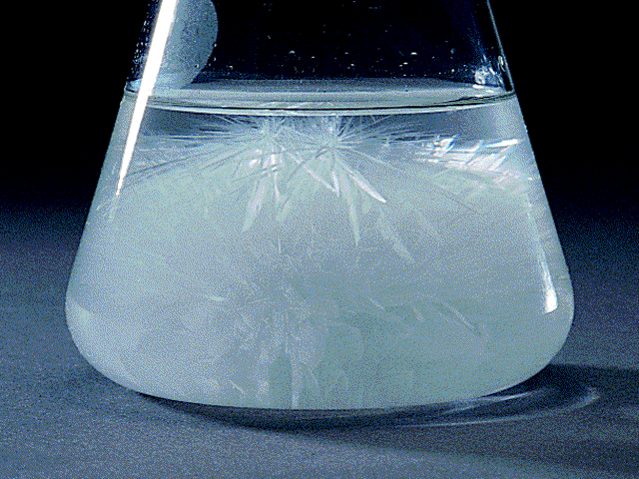
A formerly supersaturated solution -- a single crystal of the solute introduced will cause ALL of the excess solute to come out of solution suddenly!
http://www.chem.ufl.edu/~itl/2045/lectures/lec_i.html https://www.youtube.com/watch?v=BLq5NibwV5g

Slide 13
Solutions Demonstrations
Turn to the back of your notes sheet.
Ms. Bloedorn will discuss the demonstrations.

Slide 14
Closure
Turn to your row and discuss this—
Name two solutions that you encounter every day.
What are the solutes and the solvents?

