Slide 1
Conjugate A/B, pH/pOH Calculations
Chemistry GT 5/22/15

Slide 2
Drill
Ms. Bloedorn presents you with a beaker of a clear liquid. You test it and find:
It turns blue litmus red, but doesn’t change red litmus
A piece of Mg dropped into it fizzes, and eventually vanishes
Ms. Bloedorn tells you she made it by bubbling sulfur trioxide into water.
What is the identity of the liquid? How do you know?
HW: pg. 2 & 5

Slide 3
Objectives
IWBAT
Explain the properties of acids and bases.
Define Arrhenius & Bronsted-Lowry acids and bases. Determine conjugate acid/base pairs.
Name acids.
Do simple pH and pOH calculations.
NOTE: Titration Lab on Wed & Thurs next week!

Slide 4
Agenda
Drill
Conjugate Acid/Base Pairs
Conjugate Acid/Base practice

Slide 5
Conjugate Acids & Bases
Conjugate acid – what is produced when a base gains a H⁺ ion
Conjugate base – what is produced when an acid loses a H⁺ ion
Conjugate pair – two substances related to each other by the donating and accepting of a single H⁺ ion

Slide 6
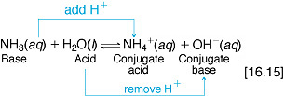
Determining the conjugate pairs

Slide 7
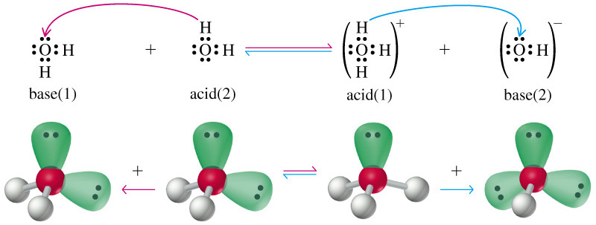
H₂O is both an acid and a base
Water is simultaneously donating and accepting protons = amphoteric substance

Slide 8
Conjugate acid-base pairs
HF + H₂O H₃O + F –
acid base conjugate conjugate
acid base

Slide 9
Practice
What would be the conjugate base for:
HCl
H₂SO₄
H₂O
What would be the conjugate acid for:
NH₃
H₂PO₄⁻

Slide 10
Bronstead-Lowry Conjugate Acid/Base Practice pg. 3 & 4
You have 10 minutes to complete the practice problems

Slide 11
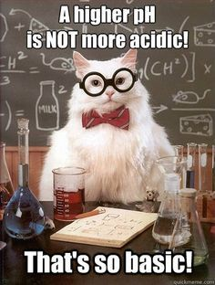
pH and pOH Calculations

Slide 12
pH + pOH = 14
pH
pOH
pH + pOH = 14
pH = -log [H⁺]
pOH = -log[OH⁻]
[H⁺] = 10^{-pH}
[OH⁻] = 10^{-pOH}
[H⁺][OH⁻] = 1.0 x 10⁻¹⁴
[H⁺]
[OH⁻]
[H⁺][OH⁻] = 1.0 x 10⁻¹⁴

Slide 13
pH and pOH
Practice on pg. 5

Slide 14
Exit Ticket
Write the name and formula for:
one strong acid
one weak acid
one strong base
one weak base
Because I’m all about that base…

