Slide 1
Intro to Impression Evidence
Forensic Science 4/20/15

Slide 2
Drill
Go to pg. 544 in the textbook and read about the OJ Simpson trial, and the impressions at the crime scene.
  What were the impressions from?
  What was the evidence linking OJ to the impressions?
  What was his defense against the evidence?
  Why didn’t the impressions have a role in his criminal trial?

Slide 3
Pd. 6 – Hair and Fiber Quiz
You need
  Pencil/Pen
  Two yellow folders
When done, pick up
  Impression Evidence packet

Slide 4
Date Announcements
Tuesday 4/21
  PM – come for make-up labs (N211)
Wednesday 4/22 – NO Lion’s Time, SMOB and SGA elections
Thursday 4/23 – PBIS (no, I don’t have a schedule)
Friday 4/24 – Fandemonium Society Meeting in N211 ☺

Slide 5
Objectives
IWBAT
  define impression evidence and give examples, such as
    tool mark
    bite marks
    shoe prints
    tire prints

Slide 6
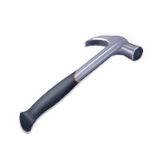
“Impressive”
Evidence
Presentation developed by T. Trimpe 2007 http://sciencespot.net

Slide 7
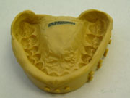
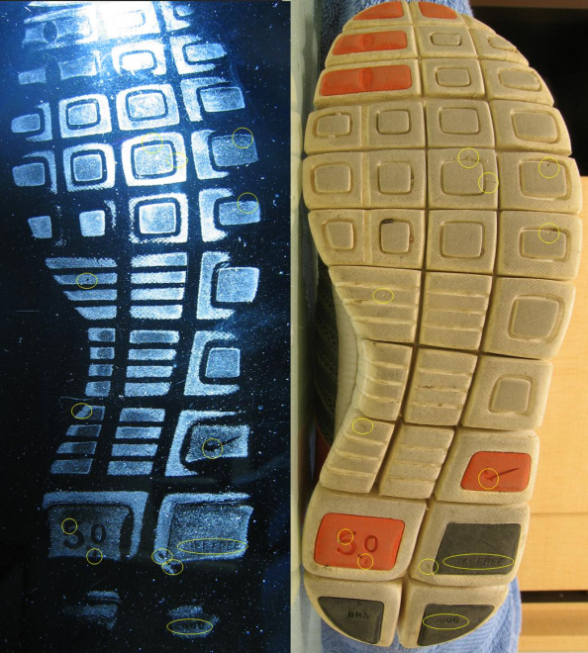
What is impression evidence?
Impression evidence can be defined as objects or materials that have retained the characteristics of other objects through direct contact.
Impressions are created when one object is pressed against another material with enough force to leave an impression of the object.
Shoeprints, tool marks, tire tracks, bite marks, and marks on a fired bullet are several examples of impression evidence.
Impressions may be found in or on many different types of materials. The quality of the impression depends on the object making the impression and the surface conditions, such as how hard or soft it is and what type of material it is (soil, mud, dust, concrete, grass, skin, etc.)
Images: http://upload.wikimedia.org/wikipedia/commons/archive/6/61/20070917141644!Shoeprint(forensic).jpg and
http://www.topmark.co.nz/images/content/tmpics01/gallery-s/SilipressionTeethMold.jpg

Slide 8
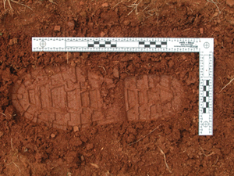
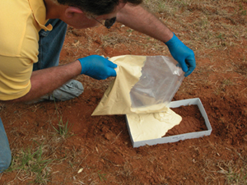
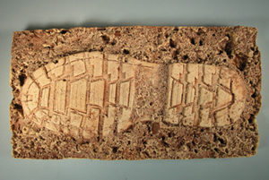
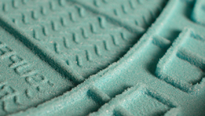
Collection Methods
Investigators analyze the impression evidence to find unique characteristics to link shoes, tires, tools, and other objects found in a suspect’s possession to evidence at a crime scene.
Collection of impression evidence can be accomplished using several methods:
2-D: This type of impression is documented using photography. Some impressions may be dusted with fingerprint powder to be photographed or lifted with tape. They may also be collected using an electrostatic dust lifting process.
3-D: This type of impression can be documented using photography as well as by casting, which involves using dental stone or a similar substance to preserve the dimensional characteristics of the print.
Example of Shoe Print in Bio-Foam Impression Foam
Images: http://www.evidentcrimescene.com/cata/cast/dscasting.html

Slide 9
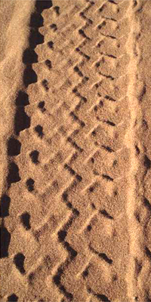
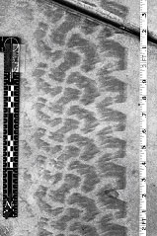
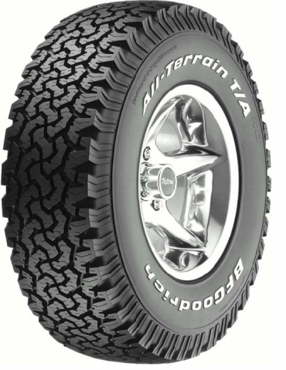
Tire Track Evidence
Tire tracks are important in forensic investigations and are usually found in road accident scenes or in the access and escape routes of other crime scenes. Tracks help investigators identify the type of vehicle that left them. Investigators may make ink prints of a tire or plaster casts of a track. They will also take photographs that can later be used to prove a match.
Features to analyze:
Tread pattern
Width & depth of the tread pattern
Unique characteristics due to the wear pattern or defects
Tire databases are available help investigators determine the brand and model of the tire that left the impression , which can be used to determine the type of vehicle that made the tracks.
Images: http://www.suite101.com/view_image.cfm/454216, http://www.ronsmithandassociates.com/FWTTS.htm.

Slide 10
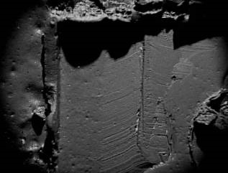
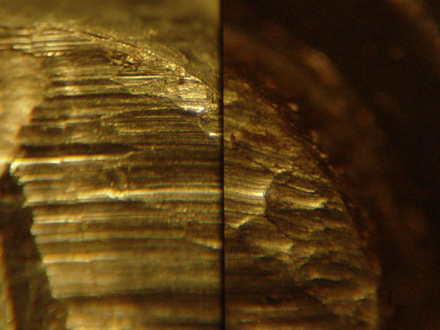
Tool Mark Evidence
Certain defects or patterns may be left on a tool when it is made or used, which can be used to find matches between evidence at a crime scene and tools or objects found at a suspect’s home.
Tool marks can be classified two ways:
Impressions – As a tool hits a softer surface, the shape of the tool and imperfections in its surface may be left behind as an impression.
Scratches – As a tool moves across a surface, it may leave ridges or striations behind.
NOTE: Some tool marks are a combination of both types.
Features to analyze:
Dimensions of the impression
Ridges or striation patterns
Defects, such as nicks and chips
Paint chips or metal shards left on a tool
Images: http://geradts.com/html/Documents/structured_files/image004.jpg and http://www.maine.gov/dps/msp/criminal_investigation/crimelab/images/toolmarks1.jpg

Slide 11
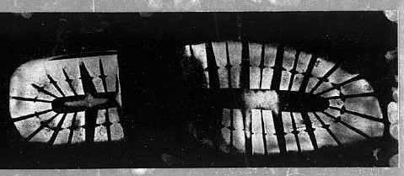
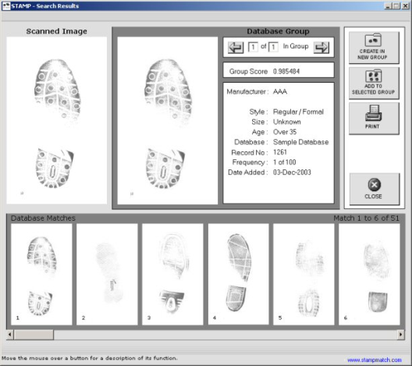
Shoe Print Evidence
Investigators can analyze a shoe print to determine its class, or the type and brand of shoe. They will also look for individual characteristics, such as wear patterns and specific damages or defects.
Databases of shoe prints are available for investigators to help them determine the brand of shoe to provide leads for a case.
Depending on the quality of the impression, investigators may be able to determine a person’s speed (walking vs. running) as well as estimate the size of a person based on the impression’s depth.
Features to analyze:
  Tread patterns, size, and depth
  Wear patterns caused by the way a person walks
  Material defects or damage (nicks, cuts, etc.)
  Other trace materials, such as soil, tar, rocks, and paint that would indicate where a person has been
STAMP Database
Shoe Print in Bio-Foam Impression Foam
Images: http://www.stampmatch.com/results.html and http://www.fosterfreeman.com/products/shoeprints/solemate/solemate.html

Slide 12
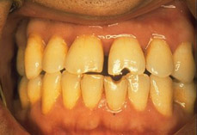
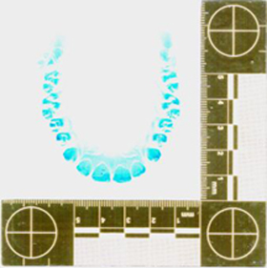
Bite Mark Evidence
Investigators can analyze bite marks for characteristics to help them identify victims or suspects as well as to exclude others. Marks can be left on a victim’s skin or other objects, such as Styrofoam cups, gum, or foods. Saliva or blood may be left behind that can be tested for DNA. Dental records including x-rays can also provide useful information, especially when attempting to identify a victim.
Features to analyze:
Type of bite mark (human or animal)
Characteristics of the teeth (position, evidence of dental work, wear patterns, etc.)
Color of area to estimate how long ago the bite occurred (old or recent bite)
Swab for body fluids for DNA tests
Did you know?
The most famous incident where bite mark evidence led to a conviction, was in the case of the notorious serial killer, Ted Bundy. He was responsible for an undetermined number of murders between 1973 and 1978 and was finally tied to the murder of Lisa Levy through bites that he had inflicted on her body.
Images: http://www.forensicdentistryonline.org/Forensic_pages_1/currentopic1.htm, http://www.trestonedental.co.uk/images/0303.jpg

Slide 13
15-2 Shoe/Foot Size and Height
Pick up the sheets for Activity 15-2.
If possible, you will have a partner of the opposite gender.
You will measure your foot and your shoe size separately, and analyze whether they are proportional to your height.

Slide 14
Pd. 3 Partners
Calderwood, Michael S | Glenn, Rose M
Savage, Najee' K | Fiorello, Kathleen M
Garner, Nathaniel D | Merrill, Anastasia D
Smith, Alexander D | Majid, Macy
Reider, Christopher J | Havrilko, Juliana K
Miller, Eric M | Freeman, Nicole E
Boone, Brett W | Addai, Kayla A
Fergusson, Tyler A | Hall, Jordan M
Siddiqi, Ashif M | Bledsoe, Michaih E
Miguelino, Nicholas E | Cholak, Maggie J
Fischer, Keenan M | Eggleston, Katherine S
Ruggles, Kayd K | Keys, Ena D
Reyna, Marley | Taylor, Reilly A
Bohan, Reid | Barbour, Logan M
Lovitt, Julian A

Slide 15
Pd. 5 Partners
Sheahin, Kevin A | Qadir, Sheeba A
Patton, Michael C | Truong, Alyssa
Schlemm, Andrew M | Haupt, Alyssa M
Ford, Cody A | Ipanaque, Jahaira D
Johnson, Jaylen M | Trevizo, Brynn E
Poligardo, Jesse P | Wade, Madeline R
Higgins, Sean D | Ton, Mary L
Cain, James N | Palmer, Jessica A
Barnhouse, Jeffrey L | Blair, Drew P
Banh, Brandon | Greengold, Deborah A
Lowenkron, Kyle S | Savje, Kelsey N
Eder, William M | Korotkin, Mitchell S
Hinson, Avery J | Watson, Jacob C
Burkindine, Austin R | Tray, Isaac A
O'Donnell, Max

Slide 16
Pd. 6 Partners
Abbey, Augustus K | Grant, Marisa N
Ombolo, Stephan M | Owusu-Sakyi, Alexia
Hastings, Austin | Eyes, Katherine D
Crawford, Casey N | Conver, Caitlyn R
Casas, Julian | Meyer, Allyson J
Williams, Nicholas R | Kisak, Natalie A
Tray, Mitchell J | Brown, Brianna N
Bassler, Michael R | Abdou, Nicole
Cole, Christopher C | Gillespie, Stephanie J
Murphy, Matthew C | Myers, Nyara N
Furr, Nicholas M | Kreeger, Mariya L
Ogden, Michael J | Strawley, John C
Saunders, Nicholas L | Boyer, Gavin K
Hendrickson-Wise, Jordan J | Gomes, Aldrin
Nadeem, Ben

Slide 17
Figure 15-8
Comparison of Foot Length and US Shoe Sizing
Foot length (in) | M | W
9 | 3 ½ | 5
9 1/8 | 4 | 5 ½
9 ¼ | 4 ½ | 6
9 3/8 | 5 | 6 ½
9 ½ | 5 ½ | 7
9 5/8 | 6 | 7 ½
9 ¾ | 6 ½ | 8
9 7/8 | 7 | 8 ½
10 | 7 ½ | 9
10 1/8 | 8 | 9 ½
10 ¼ | 8 ½ | 10
10 ½ | 9 | 10 ½
10 ¾ | 10 ½ | 12
11 | 11 ½ | 13
11 ¼ | 12 ½ | 14
11 ½ | 14 | 15

Slide 18
Pd. 3 Data
Foot vs. Shoe M | F | Shoe vs. Height M | F
2 6 -2.5 .5 -3.5 3 -3 -2.5 5.5 1.5 2.5 | 3 5 -2.5 3 -1.5 -1.5 -2 -1 -1.4 1.5 2.5 | 0 -1 0 0 2 0 0 2 3 4 6 | -2 -3 0 1 2.5 .25 -1 0 3 3 1

Slide 19
Pd. 5 Data
Foot vs. Shoe M | F | Shoe vs. Height M | F
1 -1.5 0 -3.5 -5 +2.5 1 1 -2 -2 -2 -1.5 2 -3 -1 -1 4 1.5 | -1 -1 -1 -.5 -1.5 -2 -1 -2 1.5 1 | -4 0 4 3 3 3 4 -1 0 -.5 2 0 -2 7 -2 8 2 | -1 +.50 1 0 1 0 5.5 -2 1 -2

Slide 20
Pd. 6 Data
Foot vs. Shoe M | F | Shoe vs. Height M | F
-5 -3 1 -4.5 3.5 4.5 4.5 -1 -4 2 2.5 -2 .5 | 2.5 1 -.5 0 1.5 -2.5 2 -.5 2 2.5 | -3 2 8 -9 3 2 -1 1 -2 5 -1 0 3 | 0 -6 4 -2 .5 -4 1 1 1 -7

Slide 21
Closure
How could one disguise their shoe size?
Besides the shoe print, what are some things on a shoe that could be evidence?

