Slide 1
Hair & Fiber Review & Quiz
Forensic Science 4/17/15

Slide 2
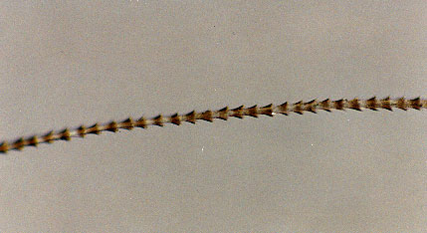
Drill
Sketch this hair.
Is it human? How can you tell?
What do you think it came from?
If you need to use the microscope, do so while we go over the drill.

Slide 3
Objectives
IWBAT
Compare and contrast human and animal hair
Describe the structure of hair and explain its utility in hair identification
Compare and contrast natural and man-made fibers

Slide 4
Agenda
Drill
Review
Ch 10 fill in the blank
Hair and Fiber Review
Kahoot
Hair & Fiber Quiz
Pick up Impression Evidence materials

Slide 5
Let’s Review!
Ch 10 fill in the blank
Hair and Fiber Review
Kahoot

Slide 6
Hair and Fiber Quiz
You need
Pencil/Pen
Two yellow folders
When done, pick up
Impression Evidence packet

Slide 7
Closure
Go to pg. 544 in the textbook and read about the OJ Simpson trial, and the impressions at the crime scene.
What were the impressions from?
What was the evidence linking OJ to the impressions?
What was his defense against the evidence?
Why didn’t the impressions have a role in his criminal trial?

