Slide 1
Limiting Reactants
Chemistry GT
3/12/14

Slide 2
Drill
Chem Joke of the Day
What does a monkey call barium with two sodium atoms?
BaNaNa
Ca + H₂O → Ca(OH)₂ + H₂
How many atoms of calcium metal are needed to react fully with 10.0 g H₂O?
1.67 x 10²³ atom Ca
HW: Limiting Reactant WS

Slide 3
Objectives
IWBAT:
Apply stoichiometric ratios to finding the mass of reactants and products
Determine the limiting and excess reactants in a chemical reaction

Slide 4
HW Review
Let’s put up the problems from Stoichiometry Review 3 WS

Slide 5
Limiting Reactant Notes
What limits a chemical reaction??

Slide 6
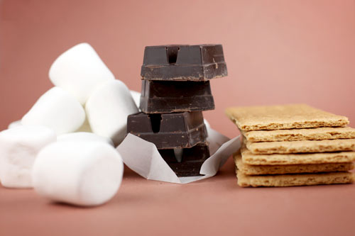
What limits the quantity of s’mores you can make?

Slide 7
Limiting Reactant
Reactant that limits the amount of product formed in a chemical reaction
The limiting reactant will be completely used up in a reaction

Slide 8
Excess Reactant
Reactant that is leftover and not consumed in a reaction

Slide 9
Limiting Reactant – Example
Predict the product(s) of the following equation
Na + Cl₂ →
Identify the limiting reactant when 1.7 g of sodium reacts with 2.6 L of chlorine gas at STP (Standard Temperature and Pressure) to produce sodium chloride.

Slide 10
Limiting Reactant – Example
1.7 g Na
1
1 mol Na
23 g Na
2 mol NaCl
2 mol Na
58 g NaCl
1 mol NaCl
x
x
x
=
4.3 g NaCl
2.6 L Cl₂
1
1 mol Cl₂
22.4 L Cl₂
2 mol NaCl
1 mol Cl₂
58 g NaCl
1 mol NaCl
x
x
x
=
13 g NaCl

Slide 11
Limiting Reactant - Example
What is the limiting reactant?
Sodium
What is the excess reactant?
Chlorine
What quantity of Chlorine is in excess?
1.7 L Cl₂

Slide 12
Practice
Work on the Limiting Reactant WS

Slide 13
Exit Ticket
1 smore is made up of 2 graham crackers, 1 marshmallow and 1 chocolate square.
If you have 4 graham crackers, 6 marshmallows and 5 chocolate squares, what is the limiting reactant?

