Slide 1
Document Examination – 4th Amendment
Forensic Science 3/11/15

Slide 2
Drill
What is a(n)
exemplar?
questioned document?
Print your name. Sign your name neatly. Sign your name quickly. Find a similarity and a difference between your different names.
HW:

Slide 3
Objectives
IWBAT
Identify the 12 traits of handwriting that may be analyzed.
Discuss document examination
How to collect document samples
The differences between written and typed document examination
The effect of alterations to the original document
Use of different sources of light to analyze a document.

Slide 4
Agenda
Drill
Analysis of the 4th Amendment writing sample
Finish Ch 16 Notes
Closure

Slide 5
Activity 10-1
First, analyze your own handwriting, using Data Table 1, then your partner’s using Data Table 2.
NOTE:
#2 – Use a ruler to measure the spaces between words, and your margins. Measure in mm.
#3 – Count the capital and lower case letters and make a ratio.
There should be a comment for each characteristic

Slide 6
Pd. 3 Pairs
Glenn, Rose M
Garner, Nathaniel D | Smith, Alexander D
Cholak, Maggie J | Miguelino, Nicholas E
Miller, Eric M | Freeman, Nicole E
Addai, Kayla A | Reyna, Marley
Fiorello, Kathleen M | Barbour, Logan M
Eggleston, Katherine S | Savage, Najee' K
Fergusson, Tyler A | Keys, Ena D
Havrilko, Juliana K | Merrill, Anastasia D
Hall, Jordan M | Fischer, Keenan M
Majid, Macy | Reider, Christopher J
Lovitt, Julian A | Bledsoe, Michaih E
Taylor, Reilly A | Ruggles, Kayd K
Calderwood, Michael S | Boone, Brett W
Bohan, Reid | Siddiqi, Ashif M

Slide 7
Pd. 5 Pairs
 | Ton, Mary L
Truong, Alyssa | Tray, Isaac A
Korotkin, Mitchell S | Watson, Jacob C
Ipanaque, Jahaira D | Greengold, Deborah A
O'Donnell, Max | Higgins, Sean D
Haupt, Alyssa M | Trevizo, Brynn E
Barnhouse, Jeffrey L | Lowenkron, Kyle S
Blair, Drew P | Hinson, Avery J
Qadir, Sheeba A | Banh, Brandon
Johnson, Jaylen M | Sheahin, Kevin A
Wade, Madeline R | Schlemm, Andrew M
Poligardo, Jesse P | Eder, William M
Burkindine, Austin R | Patton, Michael C
Savje, Kelsey N | Cain, James N
Ford, Cody A | Palmer, Jessica A

Slide 8
Pd. 6 Pairs
Hastings, Austin | Murphy, Matthew C
Nadeem, Ben | Furr, Nicholas M
Ogden, Michael J | Abdou, Nicole
Bassler, Michael R | Gillespie, Stephanie J
Casas, Julian | Saunders, Nicholas L
Myers, Nyara N | Tray, Mitchell J
Gomes, Aldrin | Meyer, Allyson J
Ombolo, Stephan M | Conver, Caitlyn R
Crawford, Casey N | Eyes, Katherine D
Grant, Marisa N | Hendrickson-Wise, Jordan J
Owusu-Sakyi, Alexia | Abbey, Augustus K
Williams, Nicholas R | Boyer, Gavin K
Kreeger, Mariya L | Strawley, John C
Brown, Brianna N | Cole, Christopher C
 | Kisak, Natalie A

Slide 9
When done…
Answer the questions about your document analysis and turn in the activity to Ms. Bloedorn. Staple your analysis to your partner’s (4 pages).
Why was it important to have the writing sample prepared ahead of time?
What is one more trait that you’d like to add to the 12 traits?

Slide 10
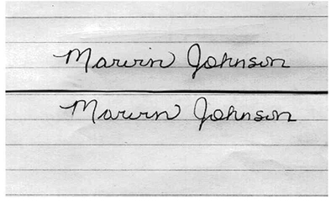
Add this!
There is ALWAYS variation in a single person’s writing—the lack of variation is a sign that the writing was traced.

Slide 11
Typewriters and Printing Devices
The two requests most often made of the examiner in connection with the examination of typewriters and printing devices are:
whether the make and model of the typewriter and printing devices used to prepare the questioned document can be identified.
whether a particular suspect typewriter or printing device can be identified as having prepared the questioned document.
In order to do this, the individual type character’s style, shape, and size are compared to a complete reference collection of past and present typefaces.
DOCUMENT EXAMINATION

Slide 12
Characteristics From Use
As is true for any mechanical device, use of a printing device will result in wear and damage to the machine’s moving parts.
These changes will occur in a fashion that is both random and irregular, thereby imparting individual characteristics to the printing device.
The document examiner has to deal with problems involving business and personal computers, which often produce typed copies that have only subtle defects.
Another area of investigation relates to the typewriter ribbon, which may contain type impressions.
DOCUMENT EXAMINATION

Slide 13
Digital Technology
In the cases of photocopiers, fax machines, and computer printers an examiner may be called on to identify the make and model of a machine or to compare a questioned document with test samples from a suspect machine.
A side by side comparison is made between the questioned document and the printed exemplars to compare markings produced by the machine.
Examiners compare transitory defect marks, fax machine headers, toner, toner application methods, and mechanical and printing characteristics.
DOCUMENT EXAMINATION

Slide 14
Alterations
Document examiners must deal with evidence that has been changed in several ways, such as through alterations, erasures, and obliterations.
Erasures by rubber erasers, sandpaper, razor blade or knife to remove writing or typing disturb the fibers of the paper and are readily apparent when examined with a microscope.
DOCUMENT EXAMINATION

Slide 15
If an alteration is made to a document with ink differing form the original, it can sometimes be detected due to differences in the luminescence properties of the inks.
Obliteration of writing by overwriting or crossing out to hide the original writing can be revealed by infrared radiation, which may pass through the upper layer of writing while being absorbed by the underlying area.

Slide 16
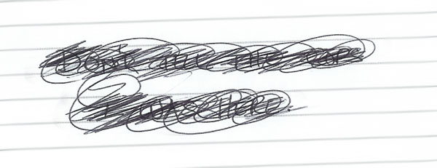
Obliteration

Slide 17
Deliberate Erasure and Overtyping

Slide 18
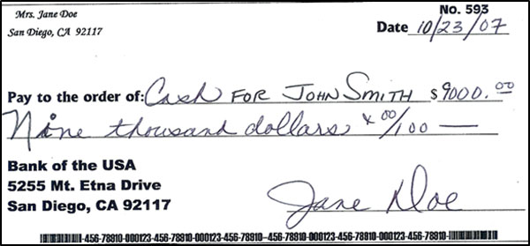
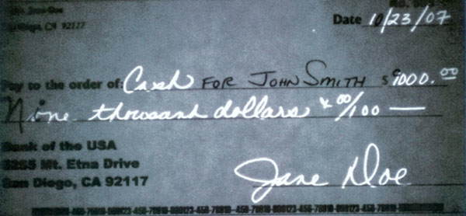
With visible vs. IR light

Slide 19
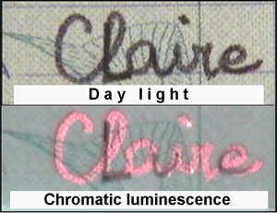

Slide 20
Other Problems
Infrared photography and reflecting light at different angles are sometimes successfully used to reveal the contents of a document that has been accidentally or purposely charred in a fire.
In certain situations, indented writings (partially visible depressions underneath the visible writing) have proved to be valuable evidence.
It may be possible to determine what was written by the impressions left on a paper pad.
DOCUMENT EXAMINATION

Slide 21
Applying an electrostatic charge to the surface of a polymer film placed in contact with a questioned document will visualize indented writings.

Slide 22
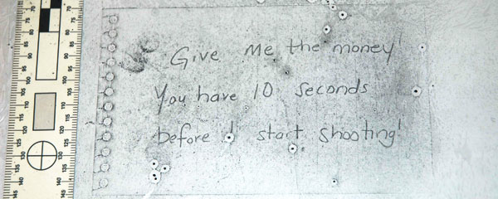
With Electrostatic Examination

Slide 23
Which pens are the same?
A study of the chemical composition of the ink used on documents may verify whether or not known and questioned documents were prepared by the same pen; and the paper itself may be analyzed.

Slide 24
Closure
Write your name:
As a signature
As if you were taking notes, or something else that is for YOU only
As you would on a paper to be turned in
Try to disguise your writing and write it again
Trade with the person across from you – what similarities and differences do you see?

