Slide 1
Organic Review Start Chemical Reactions
GT Chemistry 2/3/15

Slide 2
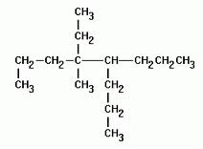
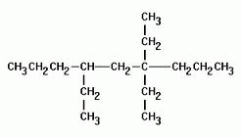
Drill
Name these compounds
HW: Study for Organic Quiz

Slide 3
Objectives
IWBAT
Differentiate between organic and inorganic compounds
Differentiate between and name alkanes, alkenes, and alkynes.
Name branched alkanes, alkenes, and alkynes.
Review naming compounds and start Unit 8: Chemical Reactions

Slide 4
Let’s review!
Take out the Organic Chemistry packet
Don’t do
I c, d, e
IV (all of it!)
Back page (Alcohols, Glycols, etc.)
I will be calling you up for Course Registration
Let’s review—draw structures on the board

Slide 5
New Packets!
Pick up the new packets in the back of the room.
Start on pg. 1 – Classwork: Nomenclature and Equation Writing. Don’t do Part 3 yet!

Slide 6
Closure
Questions for tomorrow’s quiz?

