Slide 1
Organic Practice
GT Chemistry
2/2/15

Slide 2
Drill
Draw expanded structures for
2-methyl-1,4-pentadiene
2,3-diethyl-3-propyl-nonane
HW: Study for Organic Quiz

Slide 3
Objectives
IWBAT
Draw and name alkanes, alkenes, and alkynes.
Name branched-chain alkanes

Slide 4
Practice!
Take out the Organic Chemistry packet
Cross out
I c, d, e
IV
Back page (Alcohols, Glycols, etc.)
I will be calling you up for Course Registration
Done? Work on Organic Review Sheet.

Slide 5
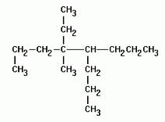
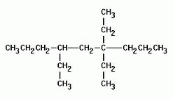
You Try!
Notes:
4-ethyl-4-methyl-5-propyloctane
4,4,6-triethylnonane

Slide 6
Closure
What questions do you have for the quiz?

