Slide 1
Pd. 3&5—Fin Lab Pd. 6 – Drug Testing Notes
2/12/15
Forensic Science

Slide 2
Drill
Pd. 3 & 5 – No Drill
Pd. 6
What do you think the white powders really were?? Why?

Slide 3
Objectives
Pd. 3&5
IWBAT
Identify an unknown white powder from multiple tests.
Explain the types of tests that a forensic scientist might use to identify illegal drugs.
Pd. 6
IWBAT
Explain the screening and confirmation tests for drugs.

Slide 4
Pd. 3&5 – Unknown Powder Lab
We will move to across the hall to the lab after Ms. Bloedorn announces the lab groups. Your lab group will go to the station that matches its number.
The procedure will be explained there.
When done, start working on questions. Bring your drug poster notes with you.

Slide 5
Pd. 3 Lab Partners
Lab Station | Partners
1 | Miguelino, Nicholas E | Freeman, Nicole E
 | Glenn, Rose M | Reyna, Marley
2 | Garner, Nathaniel D | Barbour, Logan M
 | Cholak, Maggie J | Savage, Najee' K
3 | Miller, Eric M | Keys, Ena D
 | Addai, Kayla A | Calderwood, Michael S
4 | Fiorello, Kathleen M | Merrill, Anastasia D
 | Eggleston, Katherine S | Fischer, Keenan M
5 | Fergusson, Tyler A | Reider, Christopher J
 | Havrilko, Juliana K | Smith, Alexander D
6 | Hall, Jordan M | Bledsoe, Michaih E
 | Majid, Macy | Ruggles, Kayd K
7 | Lovitt, Julian A | Bohan, Reid | Siddiqi, Ashif M
 | Taylor, Reilly A | Boone, Brett W

Slide 6
Pd. 5 Lab Partners
Lab Station
1 | Savje, Kelsey N | Watson, Jacob C
 | Ford, Cody A | Higgins, Sean D
2 | Truong, Alyssa | Lowenkron, Kyle S
 | Korotkin, Mitchell S | Trevizo, Brynn E
3 | Ipanaque, Jahaira D | Hinson, Avery J
 | O'Donnell, Max | Banh, Brandon
4 | Haupt, Alyssa M | Schlemm, Andrew M
 | Barnhouse, Jeffrey L | Sheahin, Kevin A
5 | Blair, Drew P | Eder, William M
 | Qadir, Sheeba A | Cain, James N
6 | Johnson, Jaylen M | Palmer, Jessica A
 | Wade, Madeline R | Greengold, Deborah A
7 | Poligardo, Jesse P | Patton, Michael C | Tray, Isaac A
 | Burkindine, Austin R | Ton, Mary L

Slide 7
Pd. 6 – Drug Identification
The challenge of forensic drug identification comes in selecting analytical procedures that will ensure a specific identification of a drug.
This plan, or scheme of analysis, is divided into two phases.
Screening test that is preliminary to reduce the possibilities to a manageable number.
Confirmation test that is a single test that specifically identifies a substance.
DRUGS

Slide 8
Preliminary Analysis
Faced with the prospect that the unknown substance may be any one of a thousand or more commonly encountered drugs, the analyst must employ screening tests to reduce these possibilities to a small and manageable number.
DRUGS

Slide 9
Color Tests
This objective is often accomplished by subjecting the material to a series of color tests that will produce characteristic colors for the more commonly encountered illicit drugs.

Slide 10
Type of Test | What the Results Mean
Marquis Color | Opiates – purple Amphetamines – orange-brown.
Cobalt thiocyanate | Cocaine – blue.
Dillie-Koppanyi | Barbiturates – violet-blue.
VanUrk | LSD – blue-purple.
Duquenois-Levine Test | Marijuana – purple.

Slide 11
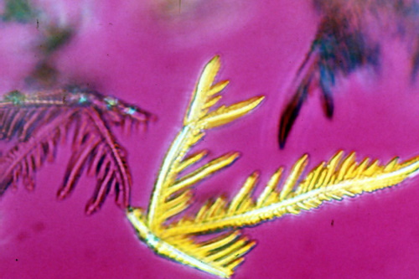
Microcrystalline Tests
Microcrystalline tests can also be used to identify specific drug substances by studying the size and shape of crystals formed when the drug is mixed with specific reagents.

Slide 12
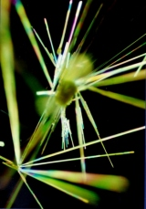
Microcrystalline Tests
Cocaine
Methamphetamine

Slide 13
Confirmational Determination
Once this preliminary analysis is completed, a confirmational determination is pursued.
Forensic chemists will employ a specific test to identify a drug substance to the exclusion of all other known chemical substances.
Typically infrared spectrophotometry or gas chromatography-mass spectrometry is used to specifically identify a drug substance.
DRUGS

Slide 14
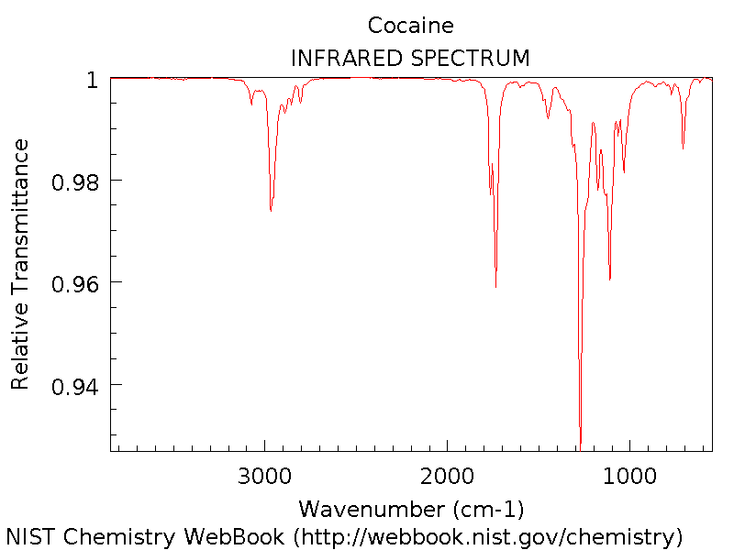
IR Spectrum of Cocaine

Slide 15
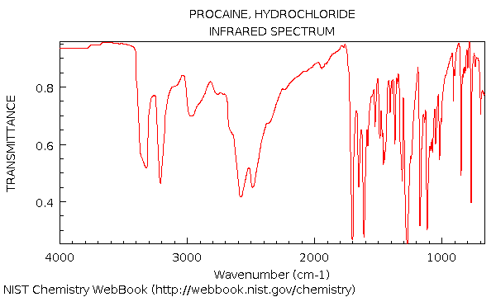
IR Spectrum of Novocaine

Slide 16
Collection and Preservation
The field investigator has the responsibility of ensuring that the evidence is properly packaged and labeled for the laboratory.
Generally common sense is the best guide, keeping in mind that the package must prevent the loss of the contents and/or cross-contamination.
DRUGS

Slide 17
Often the original container in which the drug was seized will suffice.
All packages must be marked with information that is sufficient to ensure identification by the officer in the future and establish the chain of custody.

Slide 18
Demonstration of Screening Tests Video
What is the purpose of the
positive control?
negative control?
sample?
What test was used for …? and what color did it turn? Was that as expected?
amphetamine?
heroin?
https://www.youtube.com/watch?v=hXh8pMvc3-o&noredirect=1
How is this like what you did in the lab?

