Slide 1
Bond Character, Naming Practice
Chemistry 12/9/14

Slide 2
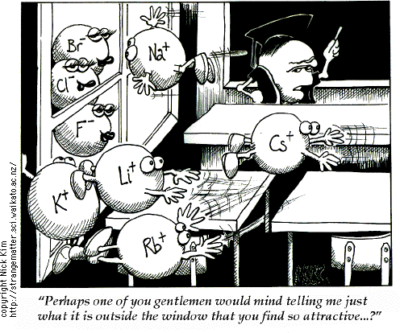

Slide 3
Drill
Write the formula:
Copper (II) chlorate
Calcium nitride
Aluminum carbonate
Potassium bromide
Barium acetate
Cesium hydroxide
HW: back of pg. 3 in packet

Slide 4
Objectives
IWBAT
Name ionic OR covalent compounds.
Use the difference in electronegativity to calculate bond character.
NOTE:
Ionic vs. Covalent Compounds Lab on Wednesday – closed toed shoes!
12/12 (Friday) – Bonding and Naming Quest (no structures)

Slide 5
Mixed Naming Practice
Let’s quickly review how to name compounds:
What are the two types of compounds?
How do you name them?
Review HW
Do Ionic & Covalent Formulas and Writing WS
Let’s review in 10 minutes

Slide 6
Electronegativity and Type of Bond
Electronegativity: Measures the attraction of an atom for electrons in the covalent bond.
How do you know if you have Ionic or Covalent Bonds?
Step 1:
Subtract the electronegativities of the two atoms in the compound. ΔEN is the difference in electronegativity.

Slide 7
Calculating Bond Type using EN
Step 2:
If the difference is smaller than 0.5 then the bond is nonpolar covalent.
If the difference is between 0.6 and 1.9, the bond is polar covalent.
If the difference is 2.0 or larger then the bond is ionic.

Slide 8
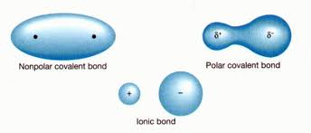

Slide 9
What type of bond is…
H₂ – 2 identical nonmetals – should be?
ΔEN = 2.1 – 2.1 = 0
Hydrogen is nonpolar covalent.
CO₂ – 2 nonmetals – should be?
ΔEN = 3.5 – 2.5 = 1.0
Carbon dioxide is polar covalent.
AsF₃ – A metalloid and a nonmetal – should be?
ΔEN = 4.0 – 2.0 = 2.0
Arsenic (III) fluoride is ionic.
NaCl – A metal and nonmetal – should be?
ΔEN = 3.0 – 0.9 = 2.1
Sodium chloride is ionic.

Slide 10
Practice
Let’s do the bottom of 7-2 Review & Reinforcement
Let’s review!

Slide 11
Closure
Why do water molecules stick together?

