Slide 1
Lewis/Polarity Practice Hybridization
GT Chemistry 12/18/14

Slide 2
Drill
Draw the following molecules—Lewis, ball and stick, and polarity (if applicable)
NH₃
CF₄
H₂S
O₃ (ozone)

Slide 3
Objective
IWBAT:
Predict the molecular shape of a molecule using the VSEPR theory
Predict the polarity of molecules based on the molecular shape
Apply hybridization to determining the orbital shape
NOTE:
Lewis Structures & Molecular Shapes QUIZ on Monday, 12/22

Slide 4
VSEPR Theory Practice
Work with the people in your table. We will review the answers as a class

Slide 5
Draw the Lewis Structures for the following molecules
Determine the shape
Determine if the molecule is polar or nonpolar
CH₃Cl
CH₂O
BeCl₂
BCl₃
PF₅
SF₆
XeF₄
SF₄
ICl₃

Slide 6
Lewis Structures for Ions
O²⁻
K⁺
ClO₂⁻¹
CN⁻¹
CO₃²⁻
SO₄²⁻

Slide 7
Hybridization

Slide 8
What is hybridization?
Atoms use their valence electrons to form bonds. But how is it that they form bonds of equal energy when some of the electrons come from the s orbital and some come from the p orbital??
Hybrid orbitals are orbitals of equal energy (between the energy of s & p orbitals) produced by the combination of two or more orbitals on the same atom.

Slide 9
Hybridization
An atom in a molecule may adopt a different set of atomic orbitals (called hybrid orbitals) than those it has in the free state.

Slide 10
The hybridization of a particular molecule is determined by the central atom.
We only need to worry about its valence electrons.

Slide 11
Your Hybridization Options:
sp
sp²
sp³
sp³d
sp³d²
sp³d³

Slide 12
Hybridization
BeF₂
Look at B
Write the orbital diagram for B
You need to have 2 e- available to bond to F
Write a new orbital diagram
Promote electrons

Slide 13
BeF₂
http://wps.prenhall.com/wps/media/objects/3081/3155729/blb0905/bl09p312b.jpg

Slide 14
Hybridization
BCl₃
Look at B
Write the orbital diagram for B
Promote electrons

Slide 15
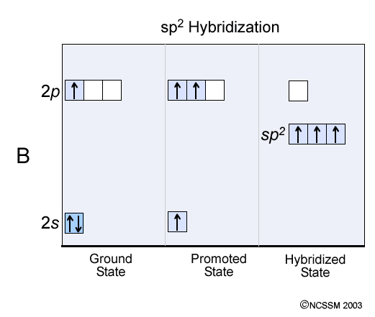
http://www.dlt.ncssm.edu/tiger/diagrams/moleculargeometry/BCl3_Hybrid.gif

Slide 16
Consider CH₄
Carbon has 4 valence electrons
1s² 2s² 2p²
2 of the electrons are in the s orbital and 2 are in the p orbital.
s & p have different shapes and different amounts of energy.

Slide 17
Consider CH₄
To create 4 equal bonds, carbon’s one 2s and three 2p orbitals fuse into 4 new identical orbitals called sp³.
2p
Hybridization
sp³
2s

Slide 18
What type of hybridization does BF₃ have?
1s² 2s² 2p¹
Empty hybridized orbitals are dropped
2p
Hybridization
sp³
So sp³ becomes sp²
2s
sp²

Slide 19
How do you include lone pairs of e- in hybridization?
Each lone pair of electrons has it’s own hybridized orbital.
See next slide.

Slide 20
What type of hybridization does H₂O have?
Oxygen e- configuration 1s² 2s² 2p⁴
(Use oxygen because it is the central atom)
2p
Hybridization
sp³
2s

Slide 21
Try this!
Draw the hybridization orbital diagram for phosphorus in PCl₃

Slide 22
Try this hybridization animation
http://www.mhhe.com/physsci/chemistry/essentialchemistry/flash/hybrv18.swf

Slide 23
Exit Ticket
Determine the hybridization of the following molecules
XeF₄
PCl₅
NH₃

