Slide 1
Blood Typing (ABO system)
Forensic Science 12/15/14

Slide 2
Drill
New Packet!
What are the formal names for:
red blood cells
white blood cells
platelets
What is coagulation?
What is the formal name for the A or B protein found on a cell?
HW: Rev Qs #2-9

Slide 3
Objectives
IWBAT
Do Punnett Squares to calculate the likelihood of different blood types, given the parents’ or children’s blood types.
Explain blood types, the history of blood typing, and agglutination.

Slide 4
Pd. 6 – Blood Typing Game
We’re going to play all together:
Blood typing game

Slide 5
Let’s talk about blood types – jot on the back of pg. 4
How is your blood type inherited?
What are the three alleles for the main gene?
What are the two alleles for the second gene?

Slide 6
Genotype vs. Phenotype
What is your genotype?
Your genotype is what your genes actually are
What is your phenotype?
Your phenotype is what is seen, how your genes are expressed
For example, someone with AO vs. AA blood have the same phenotype, but not the same genotype.
This is true for other recessive genes.

Slide 7
Practice Punnett Squares
Possible children of:
AO and BO
AB and OO
OO and OO
AB and A
A and B (How many squares???)
What about
Rh+ and Rh-?

Slide 8
More practice
ABO Blood Group Genetics
pg. 4 in packet
While you work, I’m checking HW
For #7 I^{A} = A, I = O
Let’s review

Slide 9
Blood Slides
We will be looking at 9 different species of animal’s blood, and one diseased human type.
You will be sketching them on your worksheet, and then answering questions about them.
You may want colored pencils.

Slide 10
Blood Slides

Slide 11
Human Blood

Slide 12
Sickle Cell Blood

Slide 13
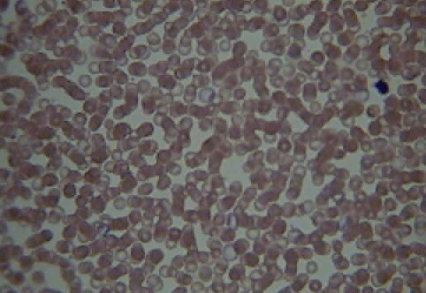
Cat Blood

Slide 14
Camel Blood

Slide 15
Bird Blood

Slide 16
Bovine Blood

Slide 17
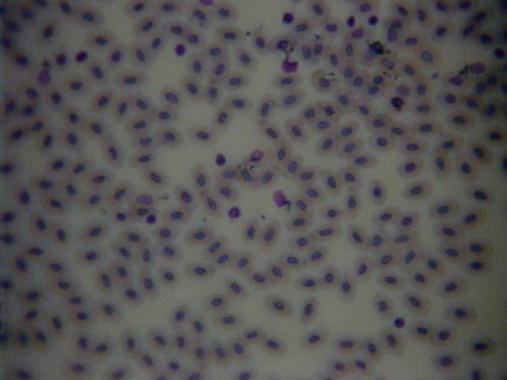
Reptile Blood

Slide 18
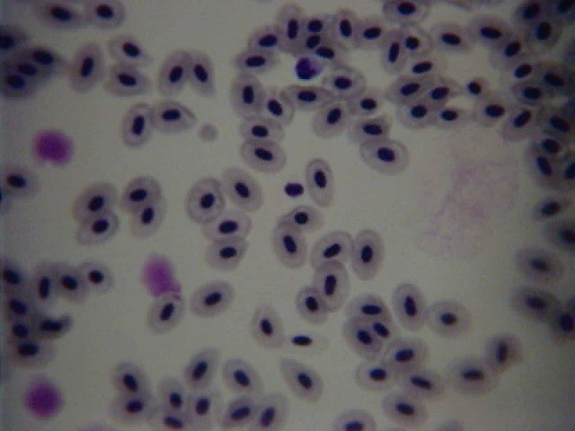
Frog Blood

Slide 19
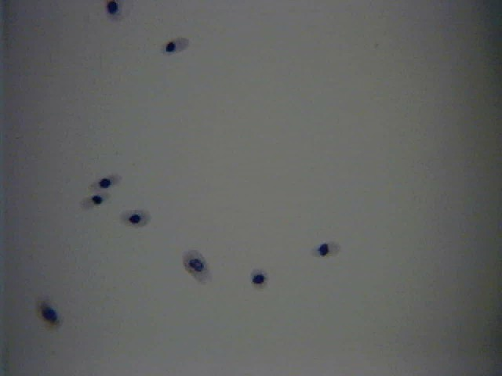
Limulus Blood – Horseshoe Crab

Slide 20
Sheep Blood

Slide 21
Blood Slide Questions
Answer the questions on a separate sheet of paper to turn in.

Slide 22
Closure
Create a Punnett square showing the possible offspring of a person with AO blood and another with AA blood.
How many genotypes are there? How many phenotypes?

