Slide 1
VSEPR Notes & Lab
GT Chemistry 12/15/14

Slide 2
Drill
Draw Lewis structures for
CH₃Br
NH₃
HCl (that’s hydrogen chloride, not carbon/iodine)
AlF₃
HW: Find an additional example for each molecular shape mentioned yesterday.

Slide 3
Objectives
IWBAT
Create Lewis structures for simple covalent compounds
Define VSEPR theory.
Identify and construct molecular shapes – linear, trigonal planar, tetrahedral, bent (trigonal planar), trigonal pyramidal (tetrahedral), bent (tetrahedral)

Slide 4
Agenda
Drill
STEM Fair Abstract discussion
Molecular Geometry/VSEPR Notes?
Molecular Shape Lab (continue)
Closure – Mole Monday!!! ☺
(on a Tuesday ☹)

Slide 5
Molecular Geometry

Slide 6
What is molecular geometry?
What does that sound like?
A molecules properties are not only determined by
what atoms are present (given in the formula)
or the bonding (given in the Lewis diagram)
but also by the 3D shape of the molecule (given by the molecular geometry)

Slide 7
VSEPR
What does VSEPR stand for?
Valence-Shell Electron-Pair Repulsions
VSEPR theory – repulsions between sets of valence electrons around an atom cause electron pairs to be oriented as far apart as possible (in 3D space)

Slide 8
What does that mean?
VSEPR explains why molecules have their shapes.
If carbon has four atoms stuck to it (as in methane), these four atoms want to get as far away from each other as they can.
This isn't because the atoms repel each other, it's because the electrons in the bonds repel each other. That's the idea behind VSEPR.

Slide 9
VSEPR Notes
For the purposes of classifying shapes and molecular geometry, a single, double, or triple covalent bond will be considered to be one bond.
Think of it like this:
single = 2 electrons shared
double = 4 electrons shared
triple = 6 electrons shared

Slide 10
Linear
Only 2 atoms in the molecule or if there are only 2 bonds on the central atom
Bond angle = 180°

Slide 11
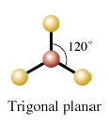
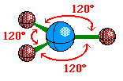
Trigonal Planar
Three bonds around the central atom
Bond angle = 120°
ex. BH₃

Slide 12
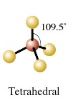
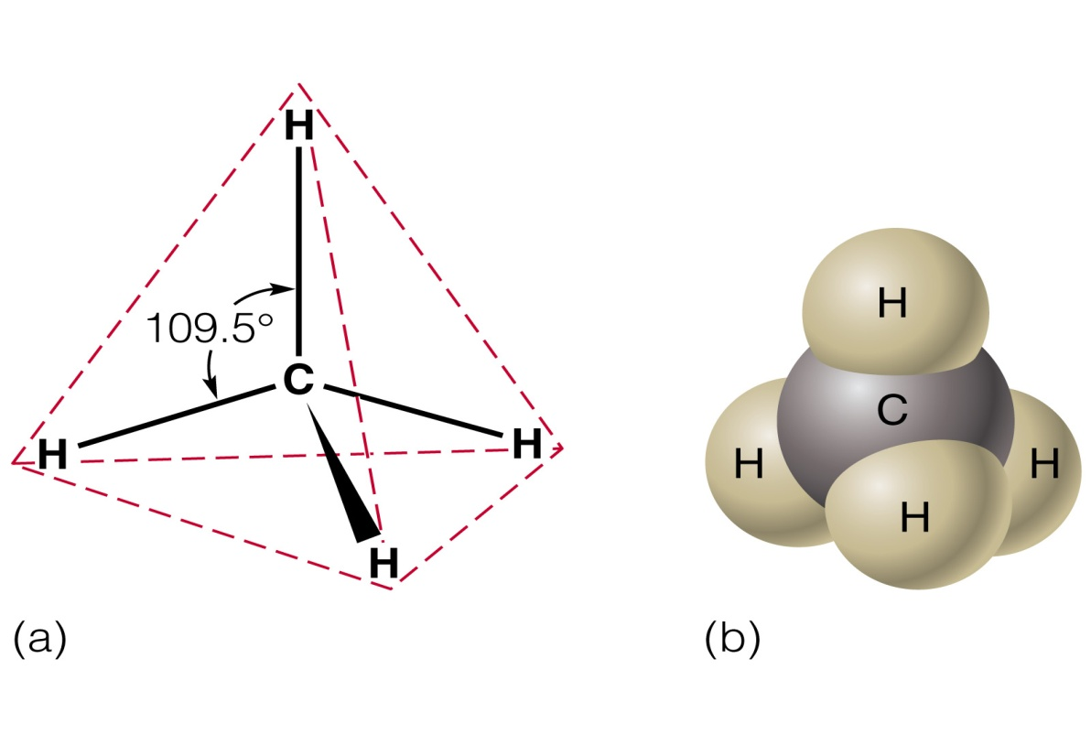
Tetrahedral
Four bonds around the central atom.
Bond angle = 109.5°

Slide 13
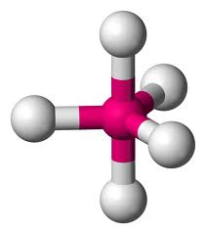
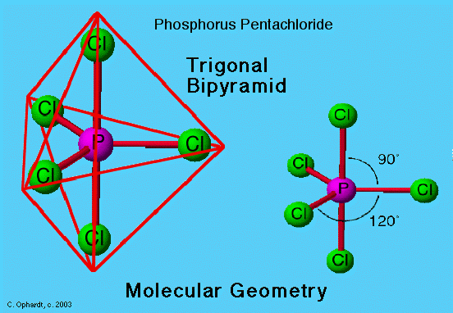
Trigonal Bipyramidal
Five bonds around the central atom
Lone Pairs: 0
Bond Angle: 120º and 90º

Slide 14
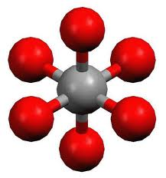
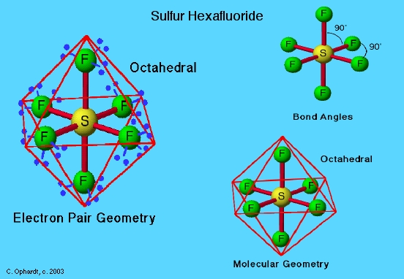
Octahedral
Description:6
Lone Pairs: 0
Bond Angle: 90⁰

Slide 15
So far we have only looked at the shapes if the electron pairs around the central atom are in bonds. We can also have unshared electrons or lone pairs around the central atom. Because they are not confined to a specific place due to bonding, they take up more space than bonded pairs.

Slide 16
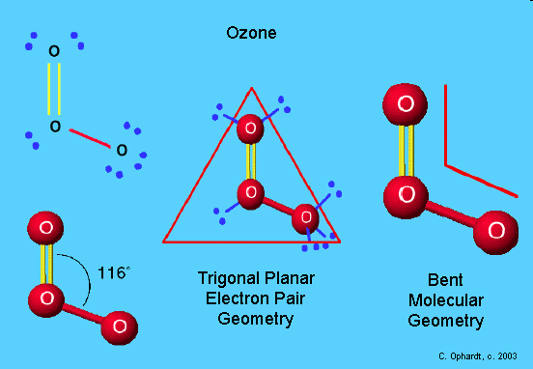
Variation of Trigonal Planar
Bent
Three electron regions around the central atom with one being a lone pair
Bond angle=116°

Slide 17
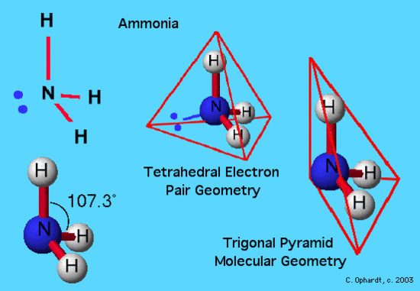
Trigonal Pyramidal (Tetrahedral)
Four electron regions around the central atom with one being a lone pair
Bond angle = 107°

Slide 18
Bent (Tetrahedral)
Four electron regions around the central atom with 2 being lone pairs
Bond angle = 105°

Slide 19
Note!
Hydrogen wants to be like the closest noble gas—which is?
So, Hydrogen breaks the Octet Rule.
Some other elements do, too.
Example: Boron – needs just 6 valence electrons
However, MOST compounds DO follow the Octet Rule!

Slide 20
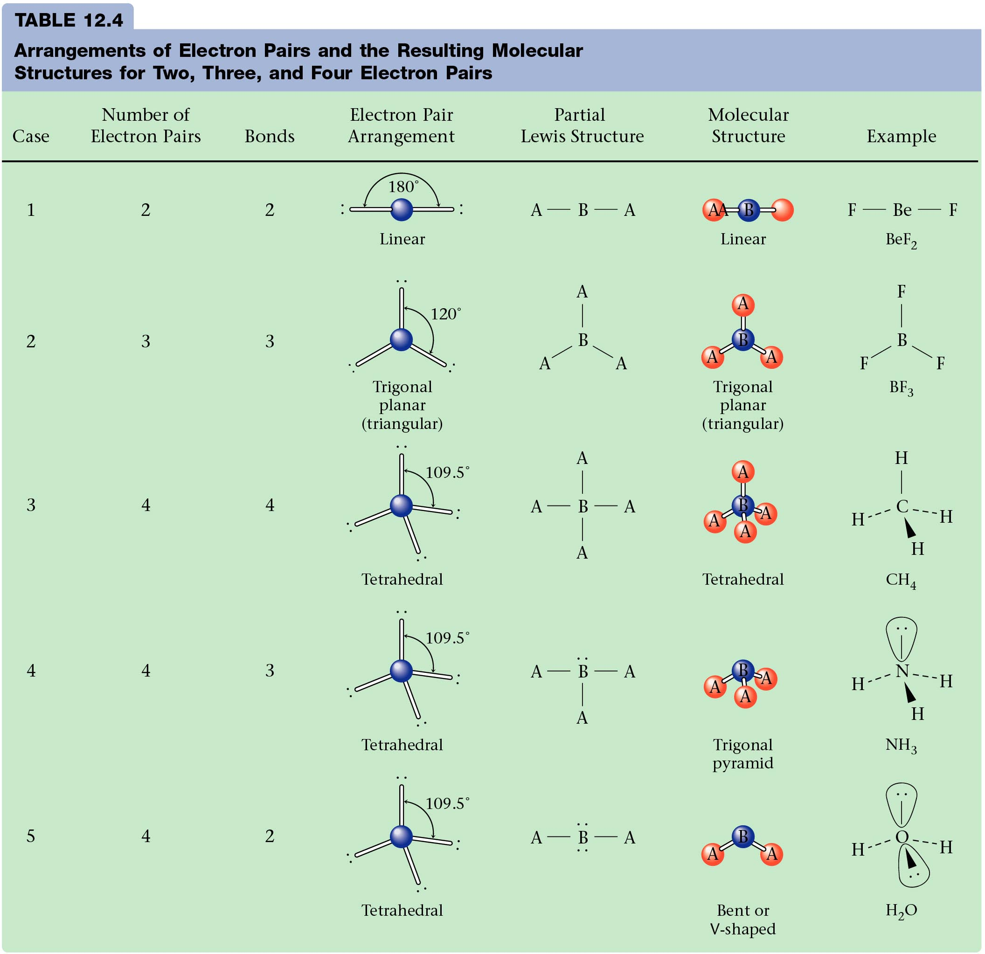

Slide 22
Molecular Shapes Lab

Slide 23
Molecular Shapes Lab Directions
Draw a Lewis Dot Structure for the molecule
Make a model using the kit and draw the shape on your paper
Write the shape name
Write the bond angle
Skip POLARITY for now, and we will come back to this part
Be careful with the kits, do not drop or lose pieces!

Slide 24
Closure – Mole Monday!
How many formula units are there in 2.4 grams of lithium oxide?
(oh, yeah, what’s the formula??)

