Slide 1
Bone Bonanza The Secret in the Cellar
Forensic Science 11/7/14

Slide 2
Drill
Determine the approximate age of skulls with the following features:
Lambdoidal suture fused. Coronal suture not fused.
Lambdoidal suture almost fused. Coronal suture not fused.
All sutures fused.
All sutures wide-open.
HW: Review Questions #12-15

Slide 3
Objective
IWBAT
Identify the bones of the skeleton
Determine sex of two skeletons
Learn about a skeleton from Colonial America

Slide 4
Agenda
Drill
Finish Bone Bonanza
Work on “The Secret in the Cellar,” sharing a computer with another pair
Closure

Slide 5
Bone Bonanza Lab
You will separate and reassemble bones of a male skeleton and a female skeleton.
Sam’s grandparents’ remains have been found, but they’re all mixed up! Help him separate them so he can put them to rest properly.
Read the Background Information

Slide 6
Bone Bonanza Lab
You and a partner (your choice) will work on this lab.
Materials
One packet per pair
Plain sheet of white paper
Scissors
Glue stick
“Lesson 4-2: Making No Bones About It!” A Lesson on Skeletal Evidence – REFERENCE, do NOT take!
Ruler
Put Grandmother on the front of your paper, and Grandfather on the back.

Slide 7
All done?
Turn in, stapled together:
Bone Bonanza lab sheet with questions answered
Grandmother’s/ Grandfather’s bones sheet
Ms. Bloedorn will assign you to a computer with your partner (you will be working with another pair)
Go to Ms. Bloedorn’s website
Main site > Forensic Science > Forensic Anthropology > Written in Bone Webcomic

Slide 8
Written in Bone
We will be investigating a forensic mystery in Colonial America:
http://anthropology.si.edu/writteninbone/comic/
There is also a link on my website.
As you go through the comic, write the answers to these Activities on a sheet of paper (one per group):
Is the skeleton male or female?
Can you identify the age?
Can you identify ancestry?
Is there evidence of trauma?
Can you determine diet?
Write a summary of how the skeleton got there.

Slide 9
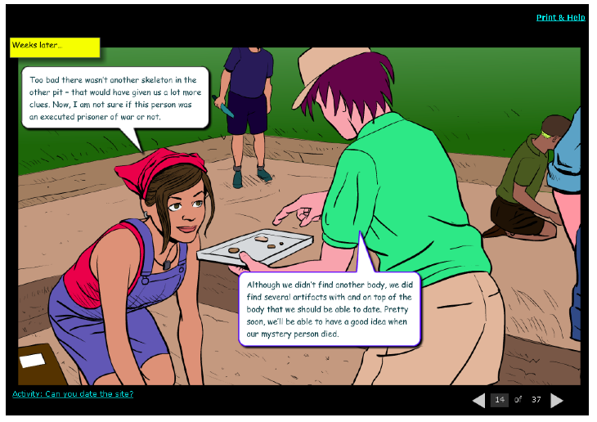
Activities??

Slide 10
Closure
Who was the skeleton?
What was the cause of death?
What else can we surmise about the skeleton?

