Slide 1
More EM Calculations
Chemistry 11/6/14

Slide 2
Drill
Define, give values, or write equations equal to these variables:
c
E
h
lambda
nu
HW: Finish Side B (and A, if not done)

Slide 3
Word of the Day
Exodus – A mass departure
After the test, there was an exodus from the room.

Slide 4
Objectives
IWBAT
Calculate wavelength and frequency for any photon.
Calculate energy for any photon.

Slide 5
Let’s go over some HW
Side B – #1, 2, 3

Slide 6
Let’s Practice
Side A
If done with Side A and B, work on pg. 5

Slide 7
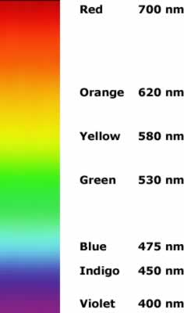
Exit Ticket
Red or Blue light
Which has a longer wavelength?
Which has a higher frequency?
Which has more energy?
Which is prettier?

