Slide 1
Advanced Periodic Trends
GT Chemistry 11/18/14

Slide 2
Drill
For the following set of elements:
Ca Sr Ba Ra
Circle the element that has the smallest atomic radius
Underline the element with the smallest ionization energy
Box the element with the greatest electronegativity value

Slide 3
Objectives
IWBAT
Use the periodic trends to solve problems
Define and use electron affinity, 2nd and 3rd ionization energy

Slide 4
Z_{eff} – why Atomic Radius has a strange trend…
Let’s imagine a Bohr model of an atom.
Let’s calculate the charge on one of the outermost electrons:
Na vs. Cl
B vs. O
Greater charge on non-metal!

Slide 5
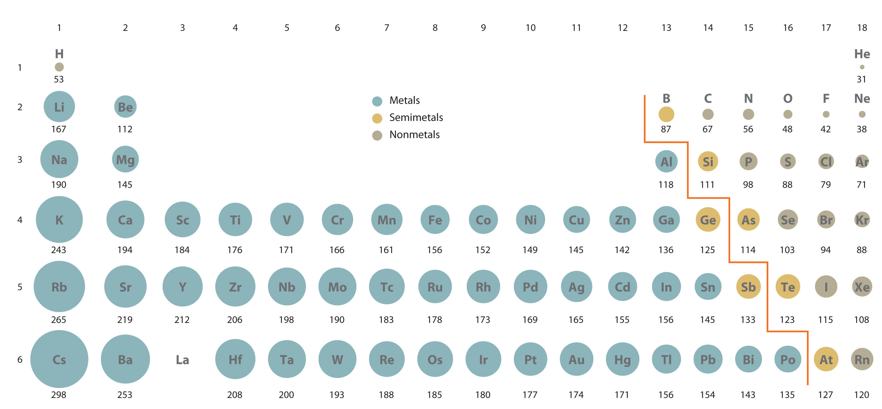
Atomic Radius

Slide 6
Ionic Radius/Electron Affinity Notes

Slide 7
Ionic Radius
When an atom gains or loses electrons the size of the radii change
Ionic radius is different for cations and anions

Slide 8
Cation
Example: Mg²⁺
Two electrons are removed
The radius gets smaller
Why?
Less repulsion between the electrons and the same number of protons in the nucleus pulls the electrons closer

Slide 9
Anion
Example: Cl¹⁻
One electron is added
The radius gets larger
Why?
More repulsion between the electrons and the same number of protons in the nucleus spreads the electrons farther apart

Slide 10
Electron Affinity
Energy change that occurs when an an electron is removed from a negative ion
Across a period
Energy becomes larger (more energy is released)
Down a family
Energy becomes smaller down a family (less energy is released)

Slide 11
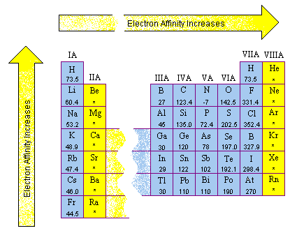
Electron Affinity

Slide 12
Ionization Energy
Can there be more than one? Why?
What we have talked about so far has been 1st ionization energy
There are actually as many ionization energies as there are electrons for an element !

Slide 13
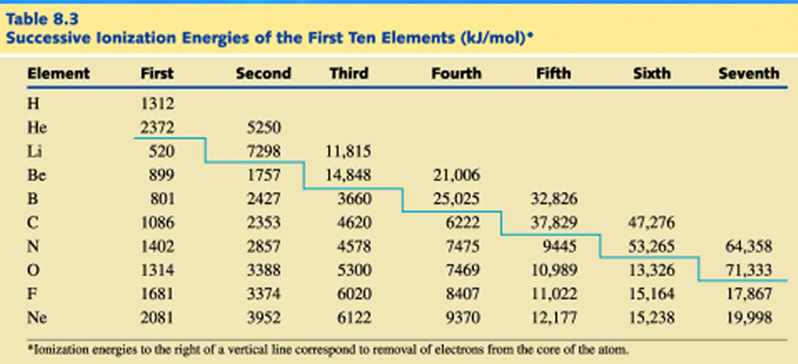
Notes:
Discuss what they notice here!

Slide 14
Let’s Practice
Today and tomorrow, you will be visiting the stations in the back of the room, and completing the problems that you can do. By the end of class on Wednesday, you should have them all done.

Slide 15
Exit Ticket
For the following set of elements:
Ba Mg O
Circle the element that has the smallest atomic radius
Underline the element with the smallest ionization energy
Box the element with the greatest electronegativity value

