Slide 1
Periodic Table, Intro
GT Chemistry 11/11/14

Slide 2
Drill
NEW SEATS!!! Put HW out on desk
Cut out the pictures found on your table. When done, put in baggies.
With your table-mates, organize them into categories.
Within each category, organize them.
How did you organize the pictures??

Slide 3
Objectives
SWBAT
Explain the contributions of Dobereiner, Newlands, Mendeleev, and Moseley to the formation of the Periodic Table.
Name the parts of the Periodic Table.
Differentiate between metals, nonmetals, and metalloids.

Slide 4
HW Review
Let’s quickly go over those questions, so you can use this for reference.

Slide 5
The Periodic Table
Mendeleev, Periodic Law, Moseley, and all that jazz

Slide 6
History of the Periodic Table
J. W. Dobereiner - 1817
Elements can be organized in sets of three:
Triads
Ex. Li, Na, K; Cl, Br, I
Average atomic masses in the middle
J. A. R. Newlands - 1865
Every eight elements, there are similar properties:
Octaves
Ex. Li, Na, K

Slide 7
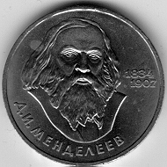
Dmitri Mendeleev, Father of the Modern Periodic Table - 1869
Dmitri Mendeleev used information about known elements to build the first periodic table.
He used:
Atomic mass
Chemical properties
Physical properties

Slide 8
Mendeleev's Periodic Table
Notice:
Increasing atomic mass in columns
Similar properties in rows
Missing elements marked with ?
First to propose elements not yet discovered!
Co & Ni – Masses do NOT go in order!

Slide 9
Henry Moseley’s Contribution
Henry Moseley made the next great leap forward with the idea of arranging by atomic number.
This fixed the few problems there had been with Mendeleev’s table.

Slide 10
Periodic Law
Thanks to Mendeleev and Moseley, we now have the Periodic Law:
When elements are arranged in order of increasing atomic number, there is a periodic repetition of their properties.
That is, you have an element with certain properties. Then, later in the Periodic Table, you have another one with similar properties. (NOT identical, but similar!)

Slide 11
Examples of Periodic Trends
Atomic radius, electronegativity, ionization energy
Similarities in reactivity
Noble gases don’t react! (Not with much, anyway)
O reacts with H to make H₂O, S reacts with H to make H₂S, Se reacts with H to make H₂Se, and so on!
Electron configurations:
O: [He] 2s² 2p⁴
S: [Ne] 3s² 3p⁴
Se: [Ar] 4s² 3d¹⁰ 4p⁴

Slide 12
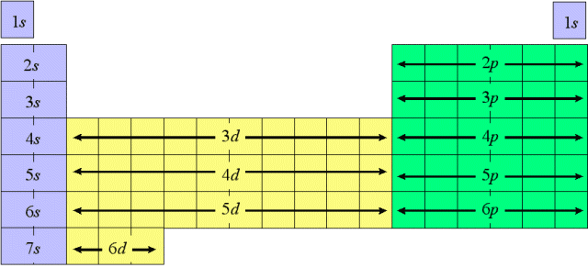
Periodic Properties
Atomic Radius Increases
Metallic Properties Increase
Electronegativity Increases
Ionization Energy Increases
Atomic Number Increases

Slide 13
Atomic Radius
Each period has one more energy level (shell) making each atom bigger.
Atomic radius measures the size of the atom.
Atomic radius of atom gets larger down a family

Slide 14
Ionization Energy Trend
Ionization Energy - The energy required to remove the most loosely held electron from the outer level of an atom in the gas phase.
H + ionization energy ➔ H⁺ + e⁻
The nucleus has + charge, attracting surrounding negative valence electrons.
Electrons farther from nucleus are easier to remove. Thus, big atoms have low ionization energy.
Electronegativity: How tightly an atom holds its electrons
Small atom has high IE.
Large atom has low IE

Slide 15
Ions
Na⁺
Cl⁻
Cations: positively charged ions
remember t = + (positive)
Would a cation have a larger or smaller atomic radius than an uncharged atom?
Anions: negatively charged ions
remember aNions are Negative
Would an anion have a larger or smaller atomic radius than an uncharged atom?

Slide 16
Metals vs. Nonmetals
The Periodic Table is divided into three major categories:
Metals
Nonmetals
Metalloids (Semi-Metals)

Slide 17
Metals, Nonmetals, and Metalloids
Blue – Metals
Yellow – Nonmetals
Pink - Metalloids

Slide 18
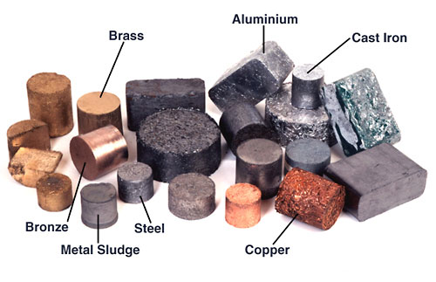
Metals
Metals are generally to
the left and the bottom
of the periodic table.
They conduct heat and electricity well.
Ex. Ag, Au, Cu
They are lustrous, malleable, and ductile.
Lustrous – shiny, reflect light
Malleable – may be pounded into sheets
Ductile – may be drawn into wires
They are usually silver-colored (except Au, Cu, Cs)
http://www.ndt-ed.org/EducationResources/CommunityCollege/Materials/Graphics/MixedMetals(mayFranInt.).jpe

Slide 19
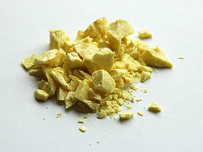
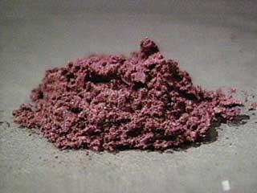
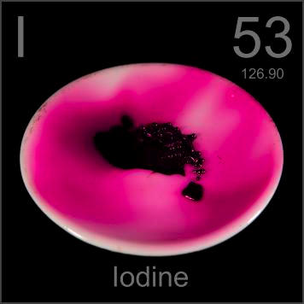
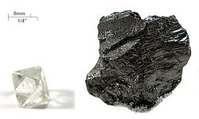
Nonmetals
Nonmetals are to the right and top of the periodic table.
They do NOT conduct heat or electricity well. They are brittle (if solid).
Many are gases, but some are solids. One liquid – bromine!
Many colors – yellow, black, red, green, etc.

Slide 20
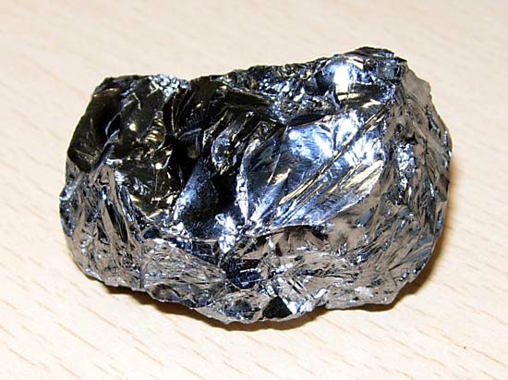
Metalloids
Metalloids are between
the metals and nonmetals.
They behave somewhat
like a metal, and somewhat like a nonmetal.
They are somewhat shiny, conduct electricity moderately, and may be slightly malleable.
Some consider hydrogen to be a metalloid; some say they are all solid, so it’s a nonmetal.
Also called semi-metals.
http://media-1.web.britannica.com/eb-media/75/131175-004-AE718B3C.jpg

Slide 21
More info. about Elements
MOST elements:
are solid
are metallic
form compounds with oxygen
are groups of single atoms (monatomic) in their elemental state
A few elemental liquids:
Br₂ and Hg
Cs and Ga become liquid at just above room temp

Slide 22
More Element Information
Eleven elemental gases:
H₂, He, N₂, O₂, F₂, Ne, Cl₂, Ar, Kr, Xe, Rn
Seven elements occur in pairs of atoms (diatomic) in their elemental state:
H₂
N₂
O₂
F₂
Cl₂
Br₂
I₂
Memorize these!

Slide 23
Alternate Periodic Tables
No, the one on the wall isn’t the ONLY way to organize it!

Slide 24
Alternate Periodic Table #1
One alternate Periodic Table puts the elements in a spiral, with “arms” for the transition metals and inner transition metals:

Slide 25
Alternate Periodic Table #2
This one, called the Tarantola Periodic Table (after the inventor) makes the s block, p block, d block, and f block the most prominent features.

Slide 26
Alternate Periodic Table #3
This one, the triangle Periodic Table, uses another organizational system to show relationships:

Slide 27
John Dalton’s List of Elements & Symbols

Slide 28
The Alexander Periodic Table

Slide 29
And two more, for fun…

Slide 30
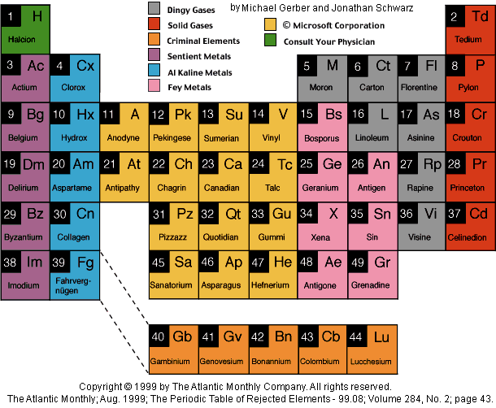
The Table of Rejected Elements

Slide 31
Wrap-up
Imagine you have just discovered a stable isotope of element 118 on Jupiter.
What noble gas configuration would it have?
What properties should it have? Why?

