Slide 1
Secret in the Cellar Bone Sex Dtmn Practice
Forensic Science 11/10/14

Slide 2
Drill
NEW SEATS
Name the bones of your arm, starting at the shoulder, going towards your hand.
Name the bones of your leg, starting at the hip, going towards your foot.
HW: Use your book and online resources to answer Qs 1-3 on the Review packet; finish the other ones as needed

Slide 3
Objective
IWBAT
Identify the bones of the skeleton
Learn about a skeleton from Colonial America
Practice using traits to determine sex from skulls and pelvises

Slide 4
Agenda
Drill
Secret in the Cellar Webcomic – Qs, with group of 4
Activity 13-2 WS – with partner
Closure

Slide 5
Written in Bone
You will be working in groups of four at one computer.
Try Firefox or Chrome (NOT Internet Explorer)
Go to Ms. Bloedorn’s website
Main site > Forensic Science > Forensic Anthropology > Written in Bone Webcomic

Slide 6
Written in Bone
We will be investigating a forensic mystery in Colonial America:
http://anthropology.si.edu/writteninbone/comic/
There is also a link on my website.
As you go through the comic, write the answers to these Activities on a sheet of paper (one per group):
Is the skeleton male or female?
Can you identify the age?
Can you identify ancestry?
Is there evidence of trauma?
Can you determine diet?
Write a summary of how the skeleton got there.

Slide 7
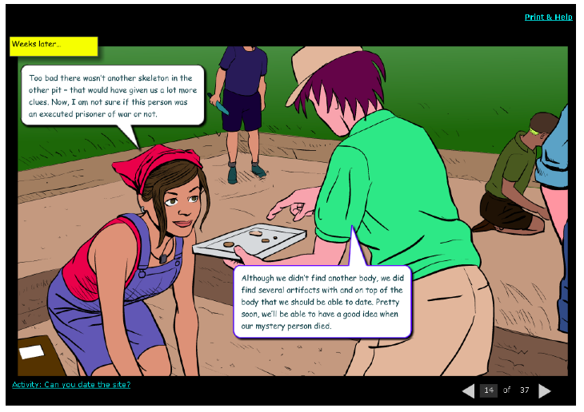
Activities??

Slide 8
Activity 13-2
You and a partner will use this worksheet and the Chapter 13 packet to answer the questions.
You may write your “Explain” answers on the back of the sheet or another sheet of paper.
For “Further Research,” you may use
Ch 13 packet
Computer
BYOD

Slide 9
Closure
With regard to “The Secret in the Cellar”
Who was the skeleton?
What was the cause of death?
What else can we surmise about the skeleton?

