Slide 1
Fireworks – Day 5 Intro to Calculations
Chemistry 10/31/14

Slide 2
Drill – Happy Halloween!
Explain what is happening in this video:
Thanks, Kaitlyn! ☺
https://pbs.twimg.com/tweet_video/B0JFfjACYAAeqr3.mp4]
HW: Finish Side A of WS

Slide 3
Objectives
IWBAT
Calculate wavelength and frequency for any photon.
Calculate energy for any photon.

Slide 4
Quiz #5
You need
Pencil/pen
CLEAN Periodic Table
Calculator (if you want it)

Slide 5
What is the electromagnetic spectrum??
Use textbooks and BYOD to answer these questions on your paper:
What is an electromagnetic spectrum?
What types of radiation are found in an electromagnetic spectrum?
What are the frequencies for ROYGBIV?
What is the difference between an emission (bright line) and continuous spectrum?

Slide 6
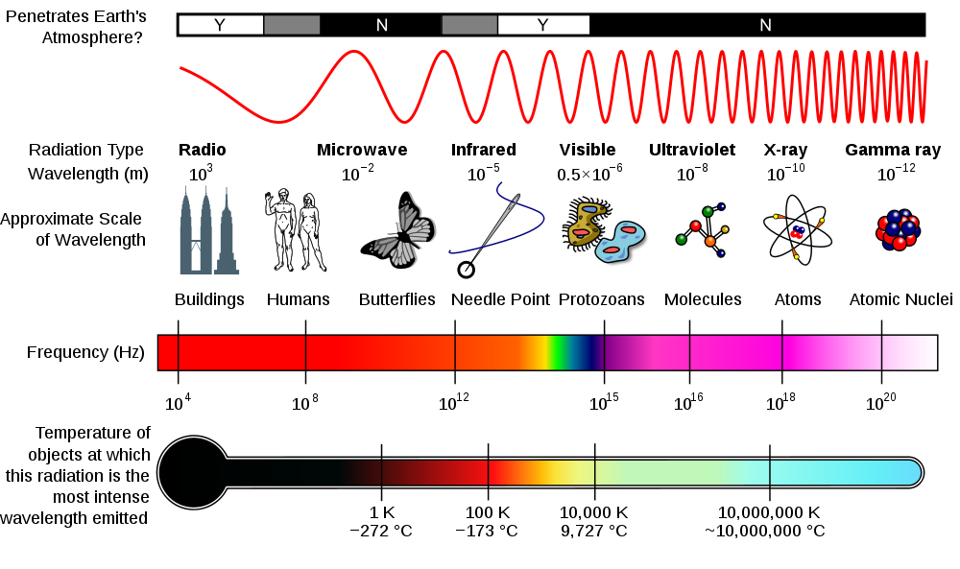

Slide 7
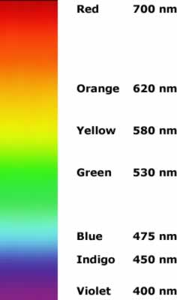

Slide 8
What does this all mean?
Turn to pg. 1 – Ms. Bloedorn will give notes about waves and light and we’ll do some example problems

Slide 9
Practice
Begin Side A of Energy, frequency, etc. WS

Slide 10
Closure
What is the symbol for
wavelength
frequency
the speed of light
energy
Planck’s constant

