Slide 1
Lifting Fingerprints using Powder
Forensic Science 10/27/14

Slide 2
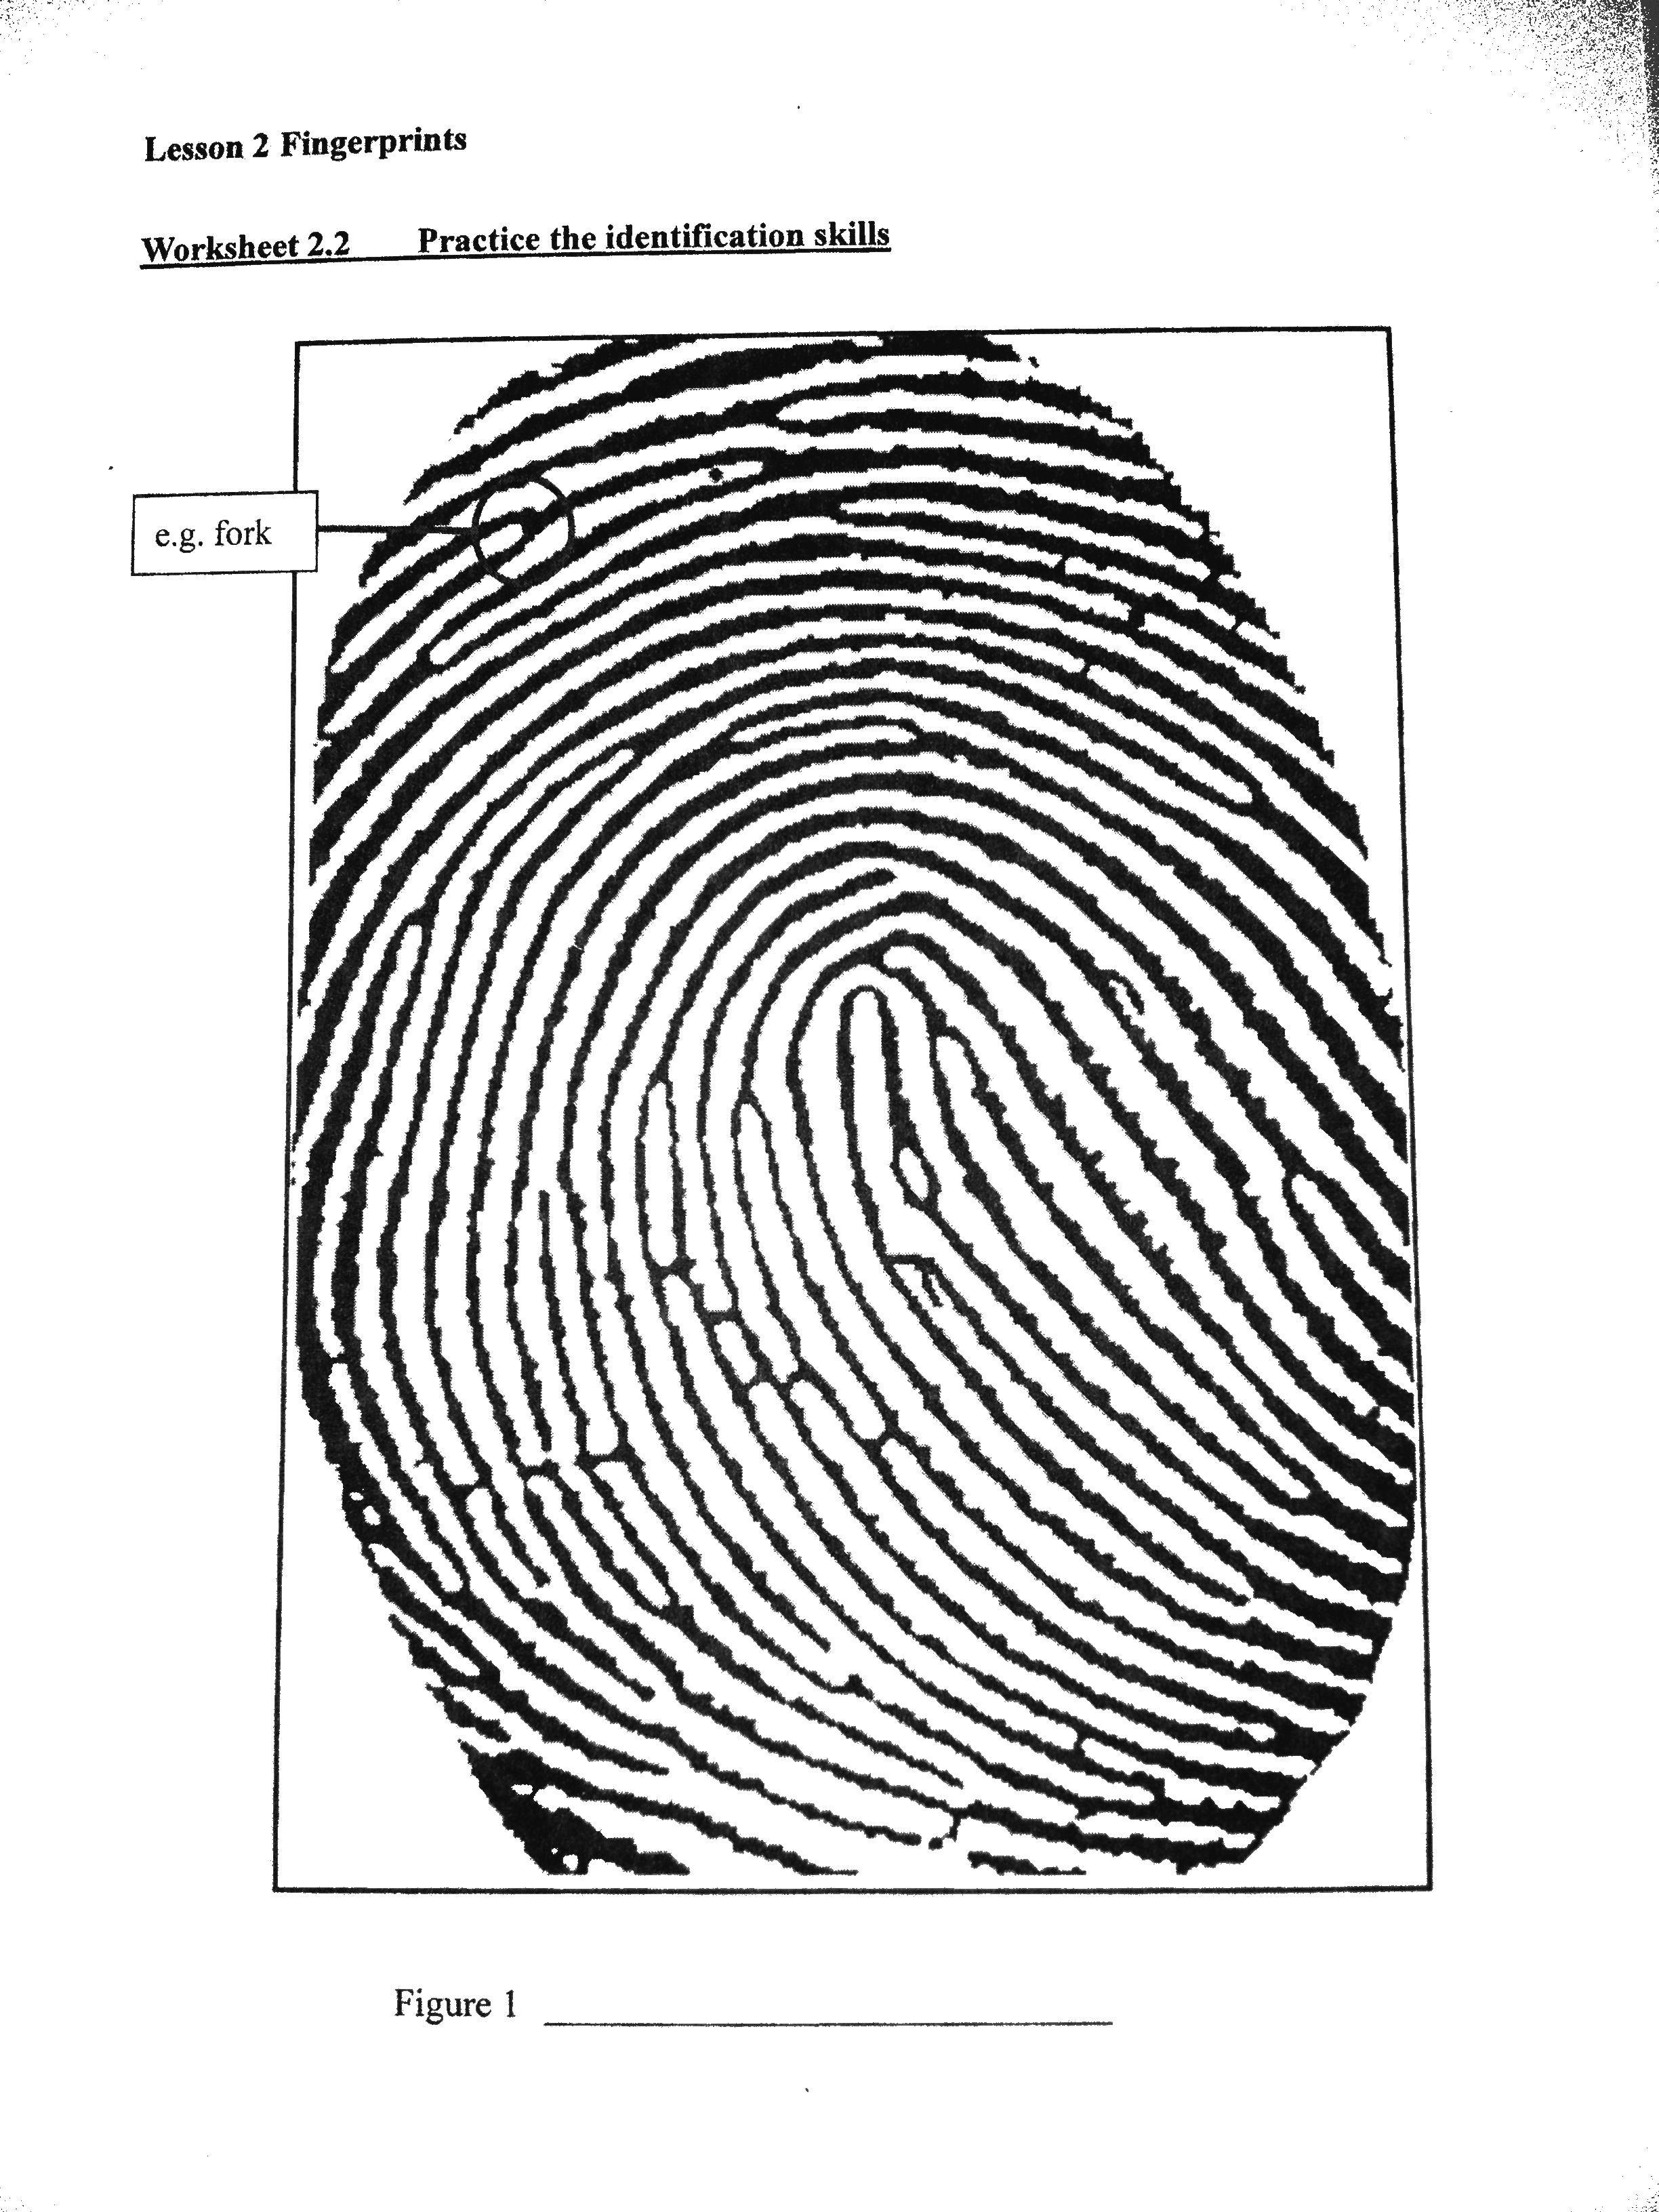
Drill
How many ridges are there between the core and the labeled fork?
Core to closest bridge?
Core to a ridge ending?

Slide 3
Objective
IWBAT
  Lift fingerprints using powder

Slide 4
Instructions
You will be assigned to a group (7 groups).
Your group will get:
  1 sheet of printer (white) paper per person (4-5 pieces)
  1 fingerprinting kit
  1 roll of packing tape
Ms. Bloedorn will carry outside:
  Microscope slides for everyone
  A small beaker for each group

Slide 5
What are we doing outside?
You will each:
  Apply a fingerprint to a slide—remember to run your fingers through your hair or on your nose or ears.
  Lift the fingerprint with packing tape and put it on your printer paper. Label it with your name.
  Do this again on the back of the slide, using a different finger.
  Dust the beaker, and lift as many prints as you can from it. Place these on the back of one group member’s printer paper. Label them “Unknown”.

Slide 6
Instructions
Ms. Bloedorn will demonstrate a good technique for applying and lifting a fingerprint, once we get outside. Remember, LESS powder is better than MORE!

Slide 7
Let’s…
Go outside and lift fingerprints!
Bonus – see if you can lift any prints from public hard surfaces!

Slide 8
Pd. 3 Groups
Bledsoe, Michaih E | Bohan, Reid | Lovitt, Julian A
Freeman, Nicole E | Addai, Kayla A | Keys, Ena D
Merrill, Anastasia D | Miller, Eric M | Siddiqi, Ashif M
Savage, Najee' K | Taylor, Reilly A | Smith, Alexander D | Eggleston, Katherine S
Reyna, Marley | Havrilko, Juliana K | Ruggles, Kayd K | Fergusson, Tyler A
Barbour, Logan M | Majid, Macy | Garner, Nathaniel D | Boone, Brett W
Miguelino, Nicholas E | Fischer, Keenan M | Glenn, Rose M | Cholak, Maggie J
Reider, Christopher J | Fiorello, Kathleen M | Hall, Jordan M

Slide 9
Pd. 5 Groups
Sheahin, Kevin A | Truong, Alyssa | Qadir, Sheeba A | Watson, Jacob C
Banh, Brandon | Eder, William M | Wade, Madeline R | Haupt, Alyssa M
O'Donnell, Max | Barnhouse, Jeffrey L | Hinson, Avery J | Higgins, Sean D
Lowenkron, Kyle S | Blair, Drew P | Savje, Kelsey N | Poligardo, Jesse P
Ford, Cody A | Tray, Isaac A | Schlemm, Andrew M | Ipanaque, Jahaira D
Trevizo, Brynn E | Burkindine, Austin R | Palmer, Jessica A | Korotkin, Mitchell S
Ton, Mary L | Cain, James N | Patton, Michael C | Greengold, Deborah A
 |  |  | Johnson, Jaylen M

Slide 10
Pd. 6 Groups
Nadeem, Ben | Boyer, Gavin K | Cole, Christopher C | Hendrickson-Wise, Jordan J
Hastings, Austin | Grant, Marisa N | Saunders, Nicholas L | Murphy, Matthew C
Conver, Caitlyn R | Casas, Julian | Williams, Nicholas R | Gomes, Aldrin
Abdou, Nicole | Strawley, John C | Kreeger, Mariya L | Crawford, Casey N
Ombolo, Stephan M | Bassler, Michael R | Brown, Brianna N | Eyes, Katherine D
Tray, Mitchell J | Owusu-Sakyi, Alexia | Abbey, Augustus K | Furr, Nicholas M
Meyer, Allyson J | Kisak, Natalie A | Ogden, Michael J | Gillespie, Stephanie J
 |  |  | Myers, Nyara N

Slide 11
All done?
Take out your inked fingerprints and identify which fingers you used for this activity. Write it next to your prints on the lab sheet.
Write a summary of the similarities and differences between the inked and powder fingerprint.
  Is one easier to see? Harder?
  Which has the most detail?
  Use a magnifying glass to find at least 5 minutiae. List them.

Slide 12
Now what?
As a group, look at the “Unknown” prints. Classify them by type, if possible. Can you see any minutiae? Do you think these all came from the same person? How can you tell?

Slide 13
Wrapping Up
Staple all the lab sheets together, with the group’s names on the front sheet.
Continue with the Review WS.

