Slide 1
Electron Configuration
Chemistry GT 10/22/14

Slide 2
Drill
Get a packet from Ms. Bloedorn and number the pages 1-12
Write the address for these elements:
  Ag
  S
  Ce
Write the full electron configuration for:
  O
  Mg
  Ga
HW: pg. 4 in new packet – Electron Configuration Practice WS

Slide 3
Objectives
IWBAT:
  Identify the “block” (sublevel), “n” (principal energy level), and “position” (number of electrons) for any element.
  Create full electron configurations for any element.
  Create Noble Gas configurations for any element.

Slide 4
Agenda
Drill
Practice electron configurations
Electron Configurations Notes
Closure

Slide 5
Electron Configuration Practice
pg. 3 – WS: Electron Configuration and Notations
  Do the configurations first
  Look at n=1 – count up the electrons (superscripts) with n=1
  Look at n=2 – count up the electrons (superscripts) with n=2
  And so on, for n=3, 4, 5

Slide 6
Electron Configuration!
1s, 2s, 2p, 3s, 3p, 4s, 3d, 4p, 5s, 4d,
5p, 6s, 4f, 5d, 6p, 7s, 5f, 6d, 7p

Slide 7
s, p, d, and f
The different sections of the Periodic Table are very important in understanding Electron Configuration.
There are 4 “Blocks” in the Periodic Table:
  the s-block, p-block, d-block, & f-block.
Remember the special rules for the d- and f- blocks:
  d – n-1
  f – n - 2

Slide 8
What do s, p, d, and f mean?
These refer to the sublevels within the principal quantum level (n).
So, for n = 1, there is only one sublevel, s.
n = 2, there are 2 sublevels: s & p
n = 3, there are 3 sublevels: s, p, & d
So, within each level, there are n sublevels.

Slide 9
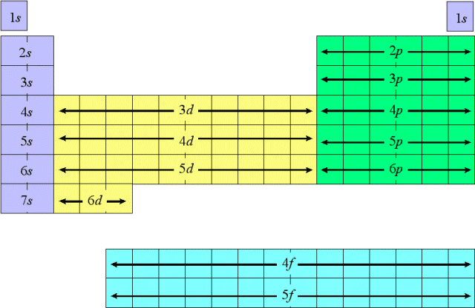
Block Table
This shows the different blocks in the Periodic Table.
It also shows in what order to write electron configurations (1s, 2s, 2p, 3s, 3p, 4s, 3d, 4p, 5s, 4d, 5p, 6s, 4f, 5d, 6p, 7s, 5f, 6d,7p)

Slide 10
An Example
As - Arsenic
1s² 2s² 2p⁶ 3s² 3p⁶ 4s² 3d¹⁰ 4p³
The first number is which row it’s in, or the principal quantum number
The character is the block it’s in, which refers to the sublevel
The superscript is the total number of electrons in the sublevel

Slide 11
The Noble Gas Configuration
An obvious solution and convenient short cut!

Slide 12
Noble Gas Configuration
The Noble Gases are:
  He, Ne, Ar, Kr, Xe, Rn
Notice that each noble gas finishes a row, or energy level.
Noble gas configurations take advantage of this by condensing what you have to write:
  Ex. He : 1s²
  Ex. C : 1s² 2s² 2p2
    Noble Gas Configuration for C: [He] 2s² 2p2

Slide 13
Noble Gas Config. – an example
The normal configuration for As-(Arsenic)
  1s² 2s² 2p⁶ 3s² 3p⁶ 4s² 3d¹⁰ 4p³
Notice, the part in yellow is the same as Argon’s configuration: 1s² 2s² 2p⁶ 3s² 3p⁶
The noble gas configuration will start with the gas in the row before it.
  [Ar] 4s² 3d¹⁰ 4p³
It cuts down on a lot of writing, and that’s a good thing.

Slide 14
Orbital Diagrams
They’re Useful!

Slide 15
Orbitals
  Each sublevel (s, p, d, f) contains orbitals.
  Remember, orbitals are electron-clouds that hold the electrons 90% of the time.
  Each orbital can hold TWO electrons, so
    s - 2 electrons, 1 orbital
    p – 6 electrons, 3 orbitals
    d – 10 electrons, 5 orbitals
    f – 14 electrons, 7 orbitals

Slide 16
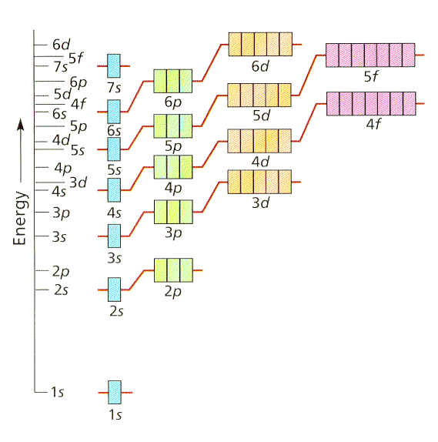
The Aufbau Principle
Each electron occupies the lowest energy orbital
  Electrons are Lazy!!!
All orbitals related to an energy level are of equal energy.
  Ex. The three 2p orbitals are the same energy level.
All equivalent energy

Slide 17
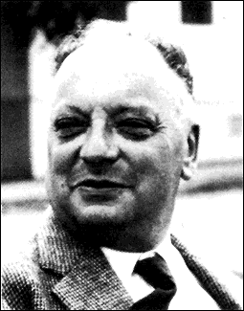
Pauli Exclusion Principle
A maximum of two electrons may occupy a single orbital, but only if the electrons have opposite spins.
  Spin -- Electrons has an associated “spin,” either one way or the other, like a top.
  These spins are called “spin up” and “spin down.”
  See example on board.
Box = orbital
Arrow = electron

Slide 18
Hund’s Rule
Single electrons with the same spin must occupy each equal-energy orbital before additional electrons with opposite spins can occupy the same orbitals.
  Electrons are UNFRIENDLY
  Why?
Ex. Nitrogen:
1s² 2s² 2p³
1s² 2s² 2p³
NOT
1s² 2s² 2p³

Slide 19
The order of Things…
Np¹
Np²
Np³
Np⁴
Np⁵
Np⁶
Electrons, being unfriendly, fill up the empty orbitals before sharing orbitals.
  Similar to seats on a bus – on a bus, you sit alone, rather than with a stranger, if there is an option.

Slide 21
The Shapes of the s, p, and d Orbitals
Sketch these in the table

Slide 22
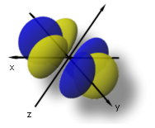
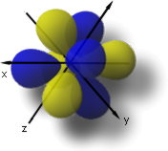
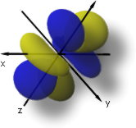
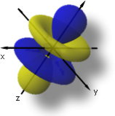
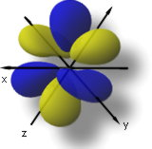
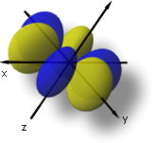
F-Orbitals!
Do not bother sketching these—just notice how STRANGE they are!
If you want to see more, go to: http://www.orbitals.com/orb/orbtable.htm

Slide 23
Visualizing Orbitals of Electrons

Slide 24
z
y
The 3 axes represent
3-dimensional space
x

Slide 25
z
y
The nucleus of the atom is at the center of the three axes
x

Slide 26
The 1s orbital is a
sphere, centered
around the nucleus

Slide 27
The 2s orbital is also
a sphere

Slide 28
The 2s electrons have a
higher energy than the 1s
electrons. Therefore, the 2s
electrons are generally more
distant from the nucleus,
making the 2s orbital larger
than the 1s orbital

Slide 29
There are three
2p orbitals

Slide 30
The three 2p orbitals
are oriented
perpendicular
to each other

Slide 31
z
This is
one 2p orbital
(2py)
y
x

Slide 32
z
Another 2p orbital
(2px)
y
x

Slide 33
z
The third 2p orbital
(2pz)
y
x

Slide 34
z
2px
y
x

Slide 35
z
2px and 2pz
y
x

Slide 36
z
The three 2p orbitals,
2p_{x}, 2p_{y}, 2p_{z}
y
x

Slide 37
Once the
1s orbital
is filled…

Slide 38
The 2s orbital
begins to fill

Slide 39
Once the 2s
orbital is
filled…

Slide 40
The 2p orbitals
begin to fill

Slide 41
Each 2p orbital
intersects the
2s orbital and
the 1s orbital

Slide 42
Each 2p orbital
gets one electron
before pairing begins

Slide 43
Once each 2p orbital
is filled with a pair
of electrons, then…

Slide 44
The 3s orbital
gets the next
two electrons

Slide 45
The 3s electrons
have a higher energy
than 1s, 2s, or 2p
electrons

Slide 46
3s electrons are
generally found
further from the
nucleus than 1s,
2s, or 2p electrons

Slide 47
e⁻ Config. and Orb. Diag. for Ions
What is an ion?
Examples of ions:
  Na⁺
  Mg²⁺
  Fe³⁺
  Cl⁻
  S²⁻
I’ll do the configs. on the overhead.
When writing electron configurations or orbital diagrams for ions it’s a little harder because it can look like a different atom.
Just subtract the missing electrons or add the extra electrons
Li⁺ (1s² 2s⁰)
NOTE
He (1s²)

Slide 48
Orbital Diagrams, online!
http://lectureonline.cl.msu.edu/~mmp/period/electron.htm

Slide 49
Closure
Write the full electron configuration for
  B
  Al
  Ga
What do they have in common?

