Slide 1
Complex Organic Chem
Chemistry 1/29/15

Slide 2
Drill
Copy down and name these structures
HW: Make sure pg. 1-3 are done in the Organic Packet

Slide 3
Objectives
IWBAT
Differentiate between organic and inorganic compounds
Differentiate between and name alkanes, alkenes, and alkynes.
Name branched alkanes, alkenes, and alkynes.
Discuss scheduling.

Slide 4
Scheduling Procedure
I have given you a half-sheet on which you will select the course (or courses) you wish to take next year.
Change GT Physics to AP Physics I
I will call students up, individually, to discuss these selections while you work on pg. 1, 2, and 3.
You do NOT have to fill out your current Math class or grade—I already have that information.

Slide 5
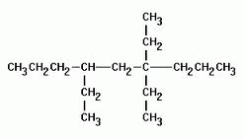
Closure
Name these

