Slide 1
Intro to Organic Chem
Chemistry 1/26/15

Slide 2
Drill
New seats!
What does “organic” mean to you? Write what comes to mind.
Get a textbook—what does “organic” mean to a chemist?
Are these the same or different?

Slide 3
Objectives
IWBAT
Differentiate between organic and inorganic compounds
Differentiate between alkanes, alkenes, alkynes and cyclic hydrocarbons

Slide 4
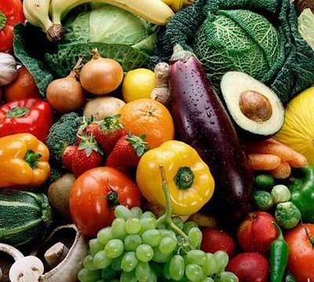
Organic Chemistry
What does “organic” mean to you?

Slide 5
Organic Compounds
An organic compound
Is a compound made from carbon and hydrogen atoms.
May also contain O, S, N, and halogens.

Slide 6
Properties of Organic Compounds
Typical organic compounds
Contain carbon and hydrogen.
Have covalent bonds.
Have low melting points.
Have low boiling points.
Are flammable.
Are soluble in nonpolar solvents.
Are not soluble in water.
Oil (organic) and
water (inorganic)
Copyright © 2007 by Pearson Education, Inc.
Publishing as Benjamin Cummings

Slide 7
Organic vs. Inorganic
Propane, C₃H₈, is an organic compound used as a fuel.
NaCl, salt, is an inorganic compound composed of Na⁺ and Cl⁻ ions.
Why is propane an organic compound, but NaCl is not?
Copyright © 2007 by Pearson Education, Inc.
Publishing as Benjamin Cummings

Slide 8
Writing Formulas for Carbon Compounds
In carbon compounds
Carbon has 4 valence electrons and hydrogen has 1.
To achieve an octet, C forms four bonds.
H H
• •
H : C : H H C H
• •
H H CH₄ , methane

Slide 9
Organic Compounds with More Carbon Atoms
In organic molecules with more carbon atoms,
Valence electrons are shared.
Covalent bonds form between carbon and carbon atoms.
Covalent bonds form between carbon and hydrogen atoms.
H H H H
• • • •
H : C : C : H H C C H
• • • •
H H H H
ethane, CH₃─CH₃

Slide 10
Alkanes
Copyright © 2007 by Pearson Education, Inc.
Publishing as Benjamin Cummings

Slide 11
Names of Alkanes
The names of alkanes
Are determined by the IUPAC (International Union of Pure and Applied Chemistry) system.
Use a prefix to indicate the number of carbons in a chain.
End in –ane.

Slide 12
IUPAC Names for Alkanes
The number of carbon atoms determines the name. For alkanes, the general formula is C_{n}H_{2n+2}
1 Meth- Methane CH₄
2 Eth- Ethane C₂H₆
3 Prop- Propane C₃H₈
4 But- Butane C₄H₁₀
5 Pent- Pentane C₅H₁₂
6 Hex- Hexane C₆H₁₄
7 Hept- Heptane C₇H₁₆
8 Oct- Octane C₈H₁₈
9 Non- Nonane C₉H₂₀
10 Dec- Decane C₁₀H₂₂
Notes:
The names of organic compounds are determined by the IUPAC rules (International Union of Pure and Applied Chemistry). The stem of the name states the number of carbon atoms in the carbon chain of the compounds. The suffix, in this case –ane, indicates the alkane family.

Slide 13
Structural Formulas
Alkanes are written with structural formulas that are
Expanded to show each bond.
Condensed to show each carbon atom and its attached hydrogen atoms.
Ms. Bloedorn will demonstrate on the board with propane.
Notes:
In methane, CH₄ the four valence electrons of carbon are shared with the single electrons of four hydrogen (H) atoms. Each pair of electrons is a single bond, which can be drawn as a line. When a structure is drawn to show each bond, it is called a complete structural formula.

Slide 16
Learning Check
A. Write the condensed formula for:
H H H H H
H C C C C C H
H H H H H
B. What is its molecular formula?
C. What is its name?

Slide 17
Learning Check
Write the condensed structural formula for
ethane
heptane

Slide 18
Closure
Draw a condensed structural formula for:
ethane
butane
hexane

